Slide 1
Integrative ATAC–RNA Modeling of Gene Regulatory Networks Using episcope
Name: Yaoxiang Li Advisor: Chunling Yi
Data: 11/03/2025
Notes:
12:00–1:00 PM in Basic Science Room 341
3:00–4:00 PM in Med-Dent Building D, Room D303

Slide 2
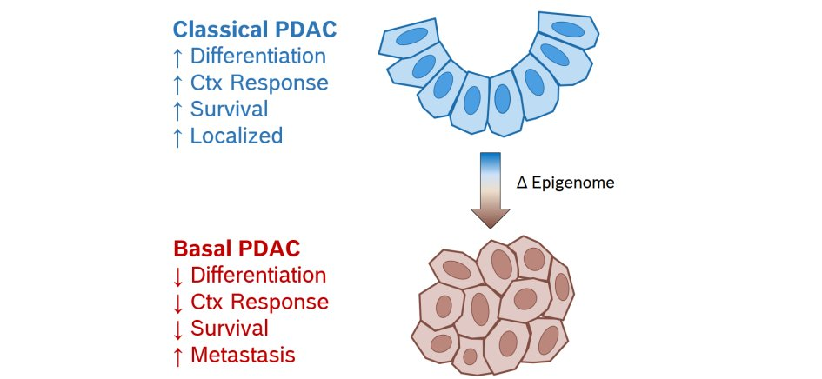
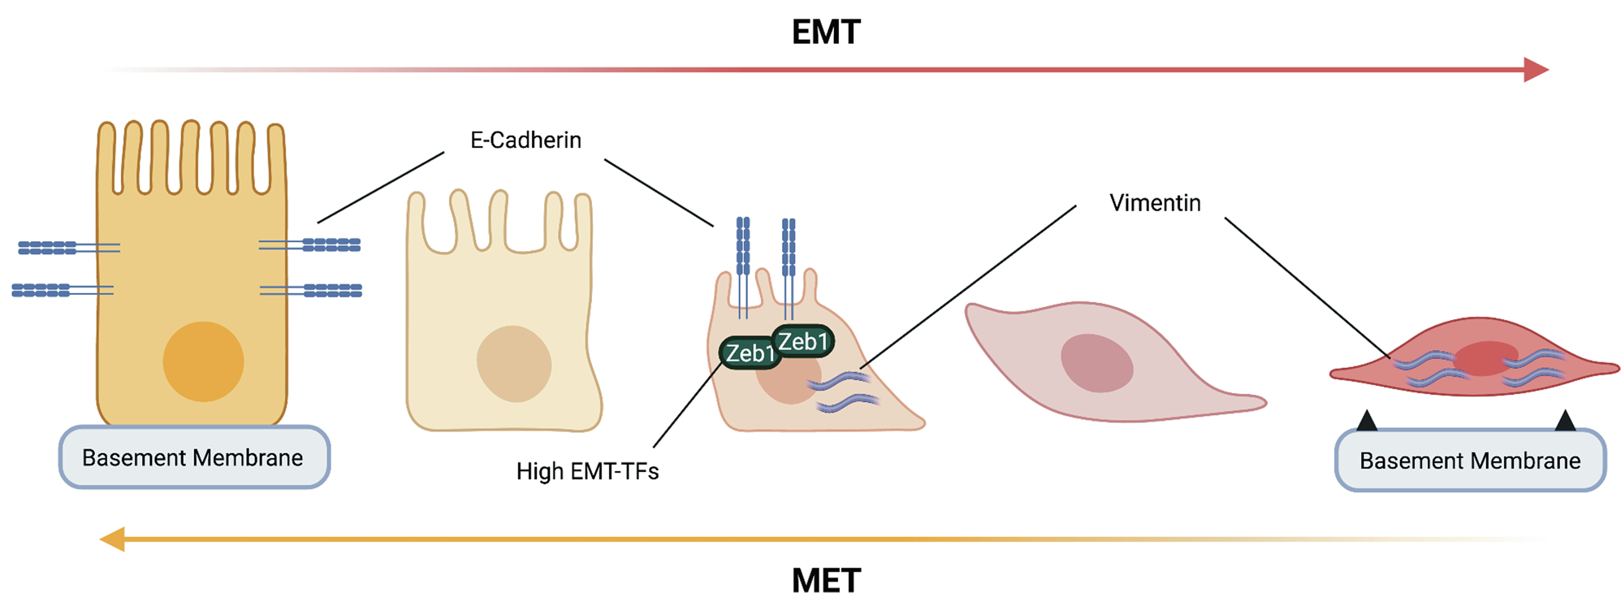
Introduction and Motivation
Lineage plasticity in Pancreatic ductal adenocarcinoma (PDAC): classical vs basal
ΔEpigenome
GATA6, HNF1A, HNF4A, ECAD, LGALS4, KLF5, etc.
ETS1, CREB1, VIM, ZEB1, HMGA2, etc.
Reference: Evan, T., Wang, V.MY. & Behrens, A. The roles of intratumour heterogeneity in the biology and treatment of pancreatic ductal adenocarcinoma. Oncogene 41, 4686–4695 (2022).
Notes:
Pancreatic ductal adenocarcinoma (PDAC) is a very aggressive cancer with a low 5-year survival rate (<10 %).
Even though many PDAC tumors share the same driver mutation (in KRAS), they differ a lot in their behavior and gene expression.
Researchers have identified two main PDAC subtypes:
Classical subtype: tumor cells look and act more like normal pancreatic duct cells; better prognosis.
Basal-like subtype: tumor cells look less differentiated, often show mesenchymal features; worse prognosis.
The difference between these subtypes is driven by transcription factors (TFs) that control cell identity:
Classical TFs include GATA6, HNF1A, HNF4A — they help maintain normal pancreatic‐duct state.
Basal-like TFs include TP63 (especially the ΔNp63 isoform) and other regulators of the squamous/mesenchymal program.
Importantly: tumor cells can switch subtype (lineage plasticity) by changing which TFs and regulatory programs are active.
Why this matters: By identifying which TFs keep a tumor in the classical vs basal state, we can find subtype‐specific vulnerabilities and potentially target them for therapy.

Slide 3
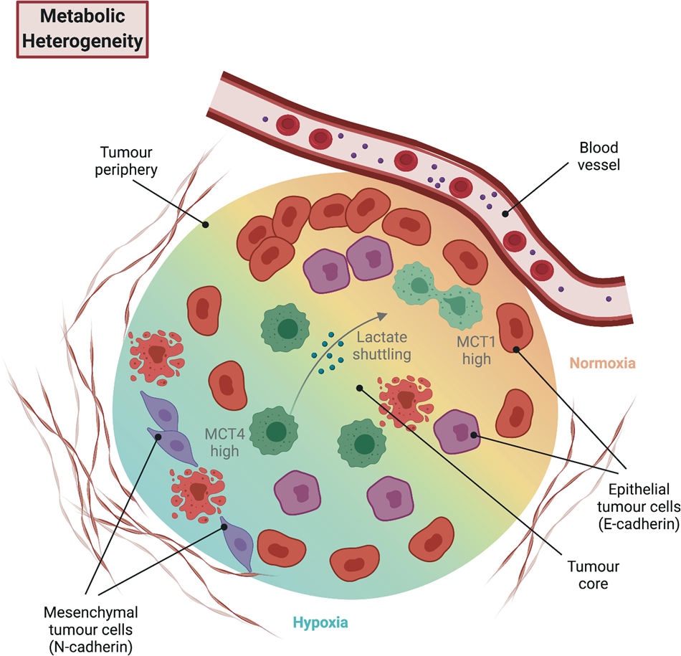
Introduction and Motivation
PDAC are spatially heterogeneous, with oxygen-rich edges and hypoxic cores.
Hypoxic core cells export lactate;
Oxygenated edge cells import and use it as fuel.
These metabolic zones tie to cell identity: cores → mesenchymal
edges → epithelial/duct-like
Reference: Evan, T., Wang, V.MY. & Behrens, A. The roles of intratumour heterogeneity in the biology and treatment of pancreatic ductal adenocarcinoma. Oncogene 41, 4686–4695 (2022).
Notes:
Cells near blood vessels are well-oxygenated, while those farther in become hypoxic.
In the hypoxic core the cells produce and export a lot of lactate; cells near vessels import that lactate and burn it.
This creates distinct metabolic zones which also map to different cell states—core cells tend to be more mesenchymal and invasive, edge cells more epithelial.

Slide 4
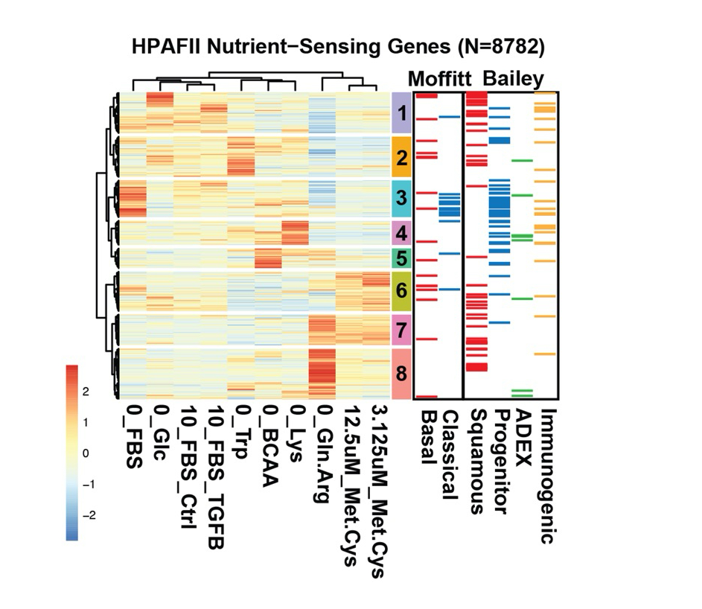
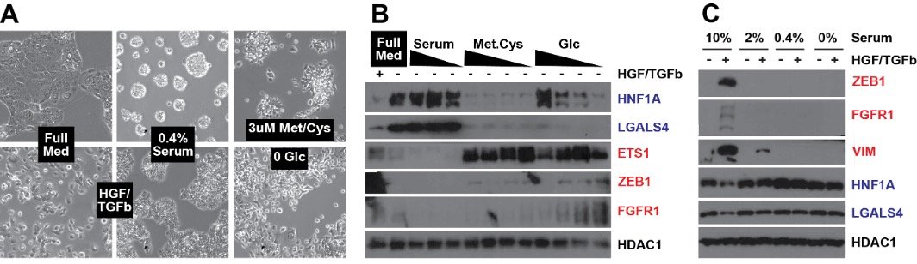
Establishing Nutrient-Deprivation Gene Signatures in PDAC
Notes:
We treated the epithelial/classical line HPAFII under various nutrient-stress conditions
Stress conditions like Met/Cys deprivation or zero glucose pushed cells toward a mesenchymal-like/basal marker pattern, similar to the effect of TGF‑β treatment; serum-reduction alone partly reversed this (middle-bottom vs TGF-β alone, bottom-left).
western blots, we see that under Met/Cys or no-glucose, classical markers drop while basal/EMT markers rise — but this shift is not seen under low serum alone.
Together, these data show nutrient stress can drive lineage/state changes (classical → basal) in PDAC cells, and we will use this framework to map the downstream epigenetic and transcriptomic programs.
We RNA-seq on HPAFII showing via the heatmap

Slide 5
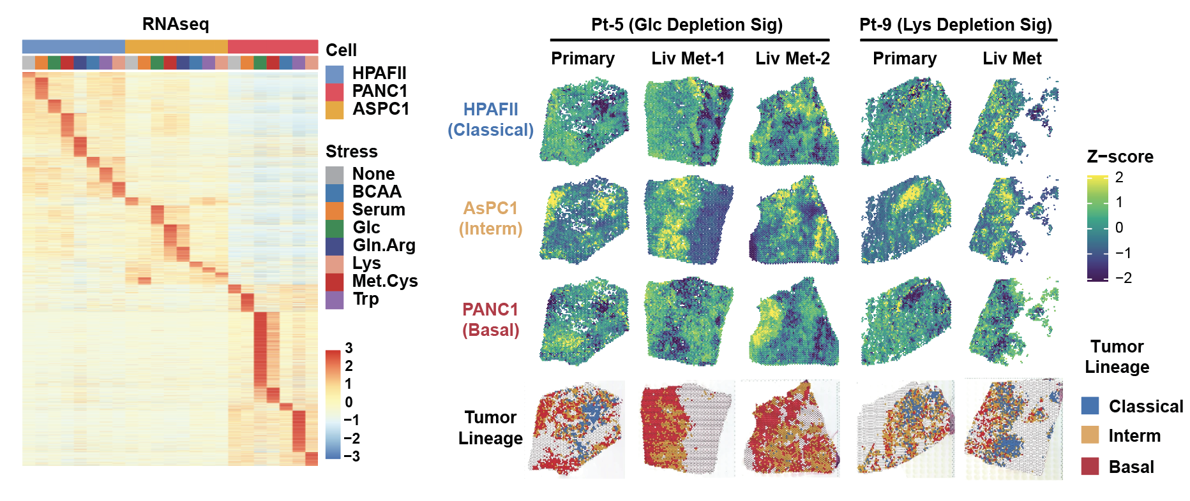
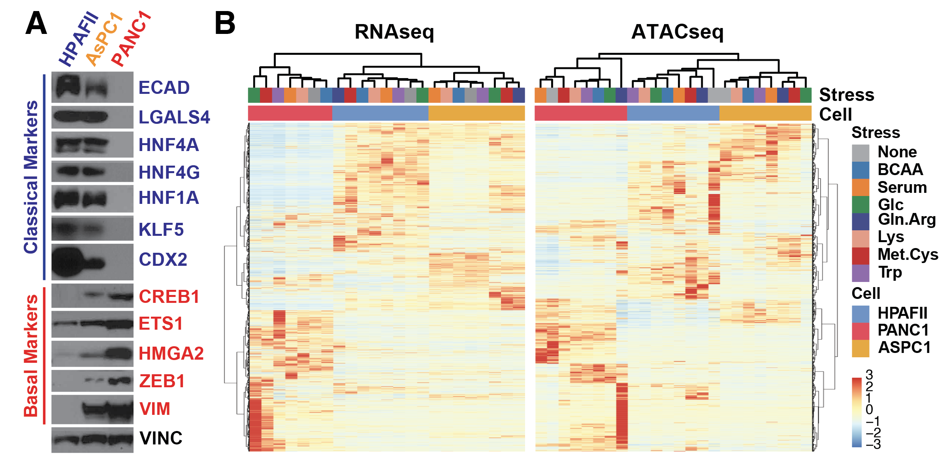
Lineage-specific nutrient-stress signatures mark distinct regions in primary and metastatic human PDAC tumours
Spatial data from 2025-Pei, et.al-Nature
Notes:
We expanded our model to three PDAC cell lines (HPAFII = classical, AsPC1 = intermediate, PANC1 = basal) under multiple nutrient-stress conditions.
The heatmap (left) shows how each stress condition aligns with classical vs basal marker patterns, defining “lineage-specific nutrient-stress signatures.”
The western blots confirm lineage plasticity across cell lines using classical. Basal markers
On the right, spatial transcriptomics data from primary and metastatic human PDAC samples show that those same nutrient-stress signature scores localize to distinct tumor regions
linking nutrient micro-environment, lineage state and tumor architecture.

Slide 6
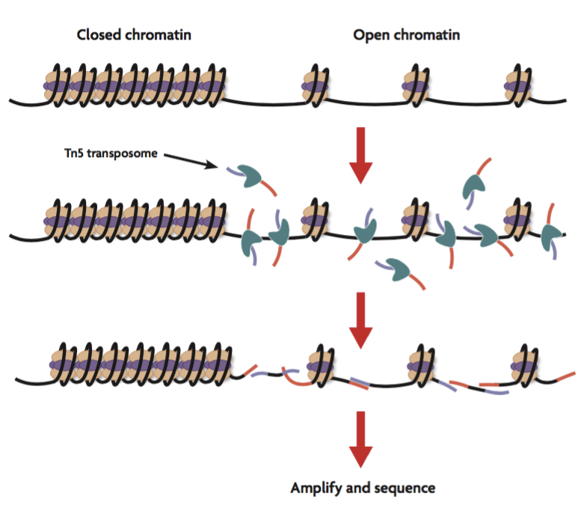
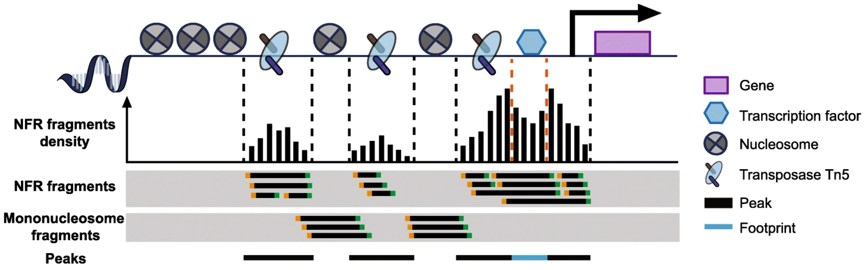
Assay of Transposase Accessible Chromatin sequencing (ATAC-seq)
Source: Yan, F., Powell, D.R., Curtis, D.J. et al. From reads to insight: a hitchhiker’s guide to ATAC-seq data analysis. Genome Biol 21, 22 (2020). https://doi.org/10.1186/s13059-020-1929-3
Notes:
ATAC-seq uses the Tn5 transposase to cut and tag open chromatin regions for sequencing, revealing where DNA is accessible
Open (accessible) regions often correspond to active regulatory elements — enhancers, promoters, and TF-binding sites
We will apply ATAC-seq across the three PDAC cell lines under all nutrient-stress conditions to map epigenomic changes (chromatin accessibility) linked to lineage and stress responses.

Slide 7
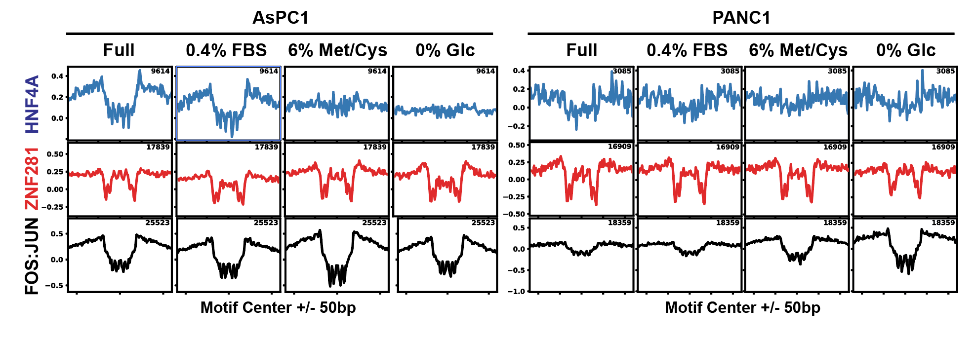
Aggregated TF Footprints Reveal Nutrient-Stress Induced Lineage Transition
Unpublished data, Yi Lab, 2025
Notes:
The aggregated footprint plots show the behavior of three TF motifs (e.g., HNF4A — classical; ZNF281 — intermediate; FOS/JUN — basal/EMT) across Full medium vs nutrient-stress (0.4% FBS, 6% Met/Cys, 0% glucose) in the ASPC1 and PANC1 cell lines.
Under Full medium, the footprint curves show deeper central dips (strong protection at motif center) for classical TFs in ASPC1, consistent with classical-identity binding.
Under Met/Cys deprivation or 0% glucose, the footprint depth for the classical TF motif declines, while the basal/EMT motif (FOS/JUN) shows increased amplitude in PANC1 — implying a switch of TF binding activity from classical to basal programmes under nutrient stress.
This data supports our model: nutrient stress remodels chromatin accessibility and TF binding footprints in a lineage‐state‐specific manner, enabling us to link nutrient conditions → TF footprint dynamics → lineage transition.

Slide 8
Paired RNA-seq & ATAC-seq Reveal Stress- and Lineage-Dependent Regulatory Shifts
Unpublished data, Yi Lab, 2025
Notes:
On the left, the heatmap shows matched RNA-seq (gene expression) and ATAC-seq (chromatin accessibility) across our three PDAC cell lines under nutrient-stress conditions.
The RNA and ATAC patterns cluster by both cell line (HPAFII, AsPC1, PANC1) and stress type (BCAA, serum, Glc, Gln/Arg, Lys, Met/Cys, Trp); this implies coordinated transcriptional + epigenomic changes.
On the right, we show how we will jointly analyse these data layers (expression + accessibility) to map how nutrient stress drives lineage state changes via regulatory network remodelling.
Aim: integrate RNA-seq + ATAC-seq to identify TFs, enhancers and chromatin states underlying lineage plasticity and nutrient-stress response in PDAC.

Slide 9
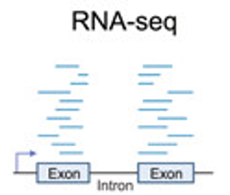
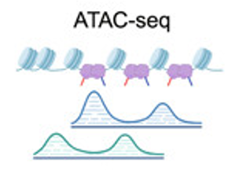
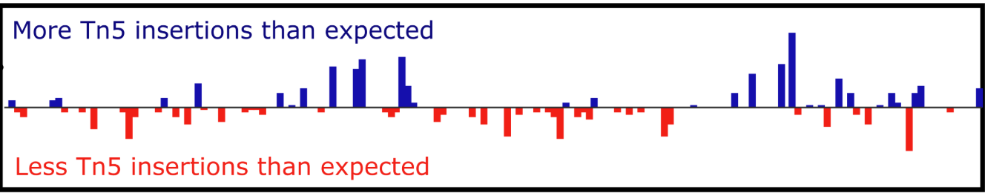
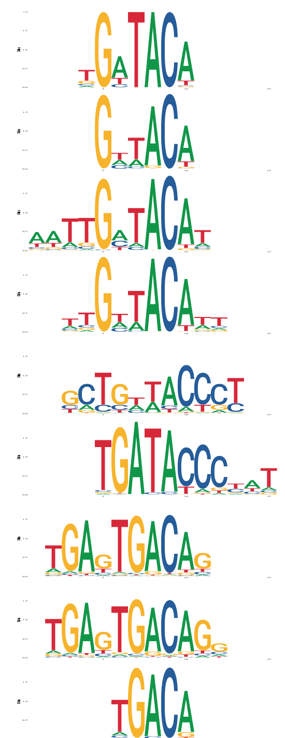

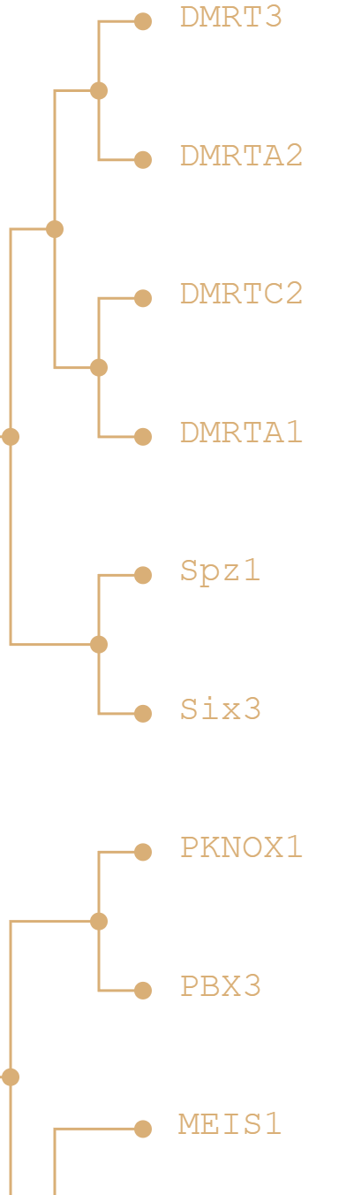
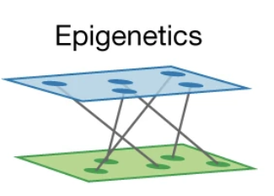
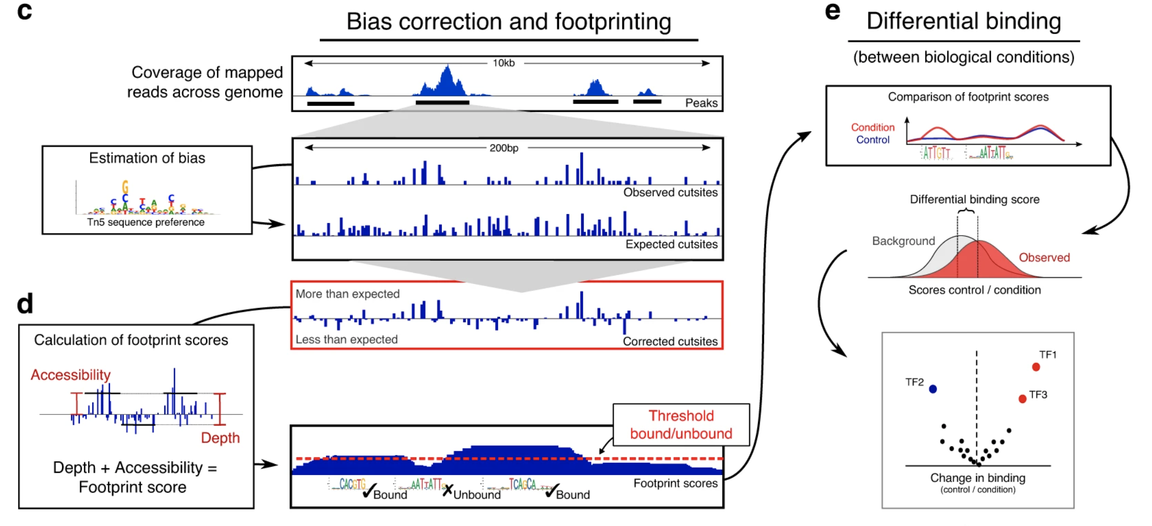

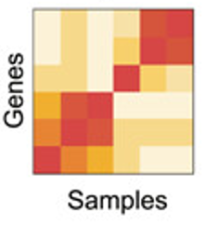
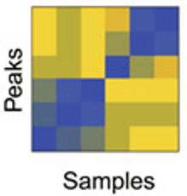
Episcope- footprint alignment & correction — integrating RNA/ATAC for gene regulatory networks (GRNs)
https://github.com/oncologylab/episcope
TFBS Databases
Preprocessing
Epigenetics
Paired quantification
Transcriptomics
Peaks
Individuals footprint score
Peaks
Footprints
Footprints
Footprints
Footprints
Footprints
footprint alignment and correction
Footprints
Footprints
Footprints
Footprints
Footprints
Footprints
Footprints
Footprints
Footprints
Footprints
Footprints
Footprints
Footprints
Footprints
Footprints
Footprints
Footprints
After the footprint alignment and correction, n of unique footprints drops from ~10M to ~1.5M
Unpublished data, Yi Lab, 2025
Notes:
We developed Episcope, a tool that integrates paired RNA-seq and ATAC-seq data to reconstruct gene regulatory networks (GRNs).
In the first step, we perform footprinting — using ATAC-seq to locate transcription factor (TF) binding sites based on where the transposase cannot cut. We map these footprints through TF binding site (TFBS) databases, such as JASPAR and HOCOMOCO, shown on the right. Each motif represents a DNA sequence pattern recognized by a TF. You can see that some motifs look very similar — for example, members of the same TF family share nearly identical patterns. When analyzed individually, that’s fine, but when we merge data across samples and conditions, these similar motifs create redundant footprints, effectively over-counting the same regulatory regions and introducing noise.
To fix this, we built a data-driven footprint alignment and correction algorithm. Technically, the algorithm:
Reads footprint score, bound, and annotation tables for every motif.
Parses genomic coordinates and computes a midpoint for each footprint.
Groups footprints that lie within a small tolerance (e.g., ±10 bp) and show highly similar score patterns (≥ 80% match across samples).
Merges those redundant signals into unified aligned footprints tied to a single ATAC peak.
each footprint-to-peak mapping is one-to-one, reducing tens of millions of raw footprints down to ~1.5 million high-confidence regulatory sites.
This alignment step removes duplication across similar motifs and conditions, giving us a cleaner, more biologically meaningful basis to link footprints to gene expression in the next GRN-building stage.

Slide 10
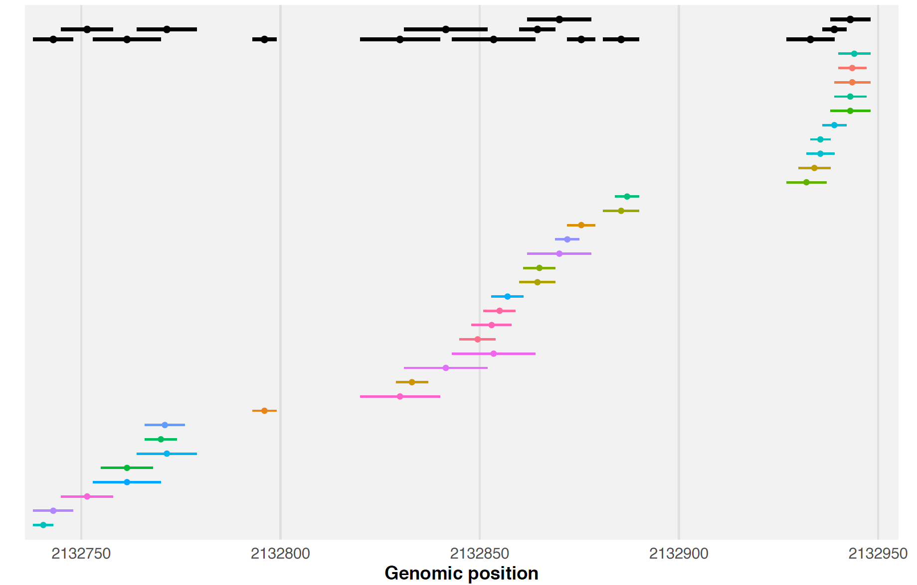
TFBS within ATAC peak: chr20:2132736-2132955 (n TFBS shown = 34, merged clusters = 15)
region = ATAC peak; segments = TFBS intervals; dots = TFBS midpoints. Top = merged clusters (auto−stacked across rows to reduce crowding).
Unpublished data, Yi Lab, 2025
Notes:
one example ATAC peak containing 34 footprints, many of which overlap. Each bar represents a footprint; overlapping intervals indicate redundant motif hits from different TFs or motif variants. We group these into 15 merged clusters to reduce redundancy and improve interpretability. This illustrates why footprint alignment and clustering are essential before downstream TF assignment.

Slide 11
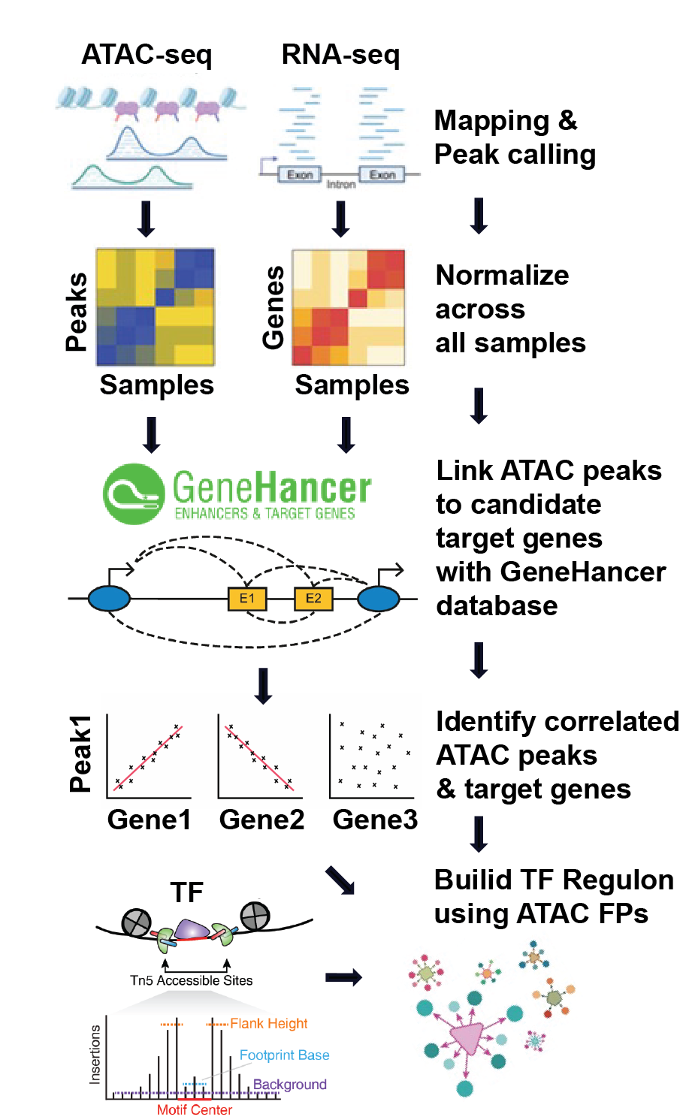
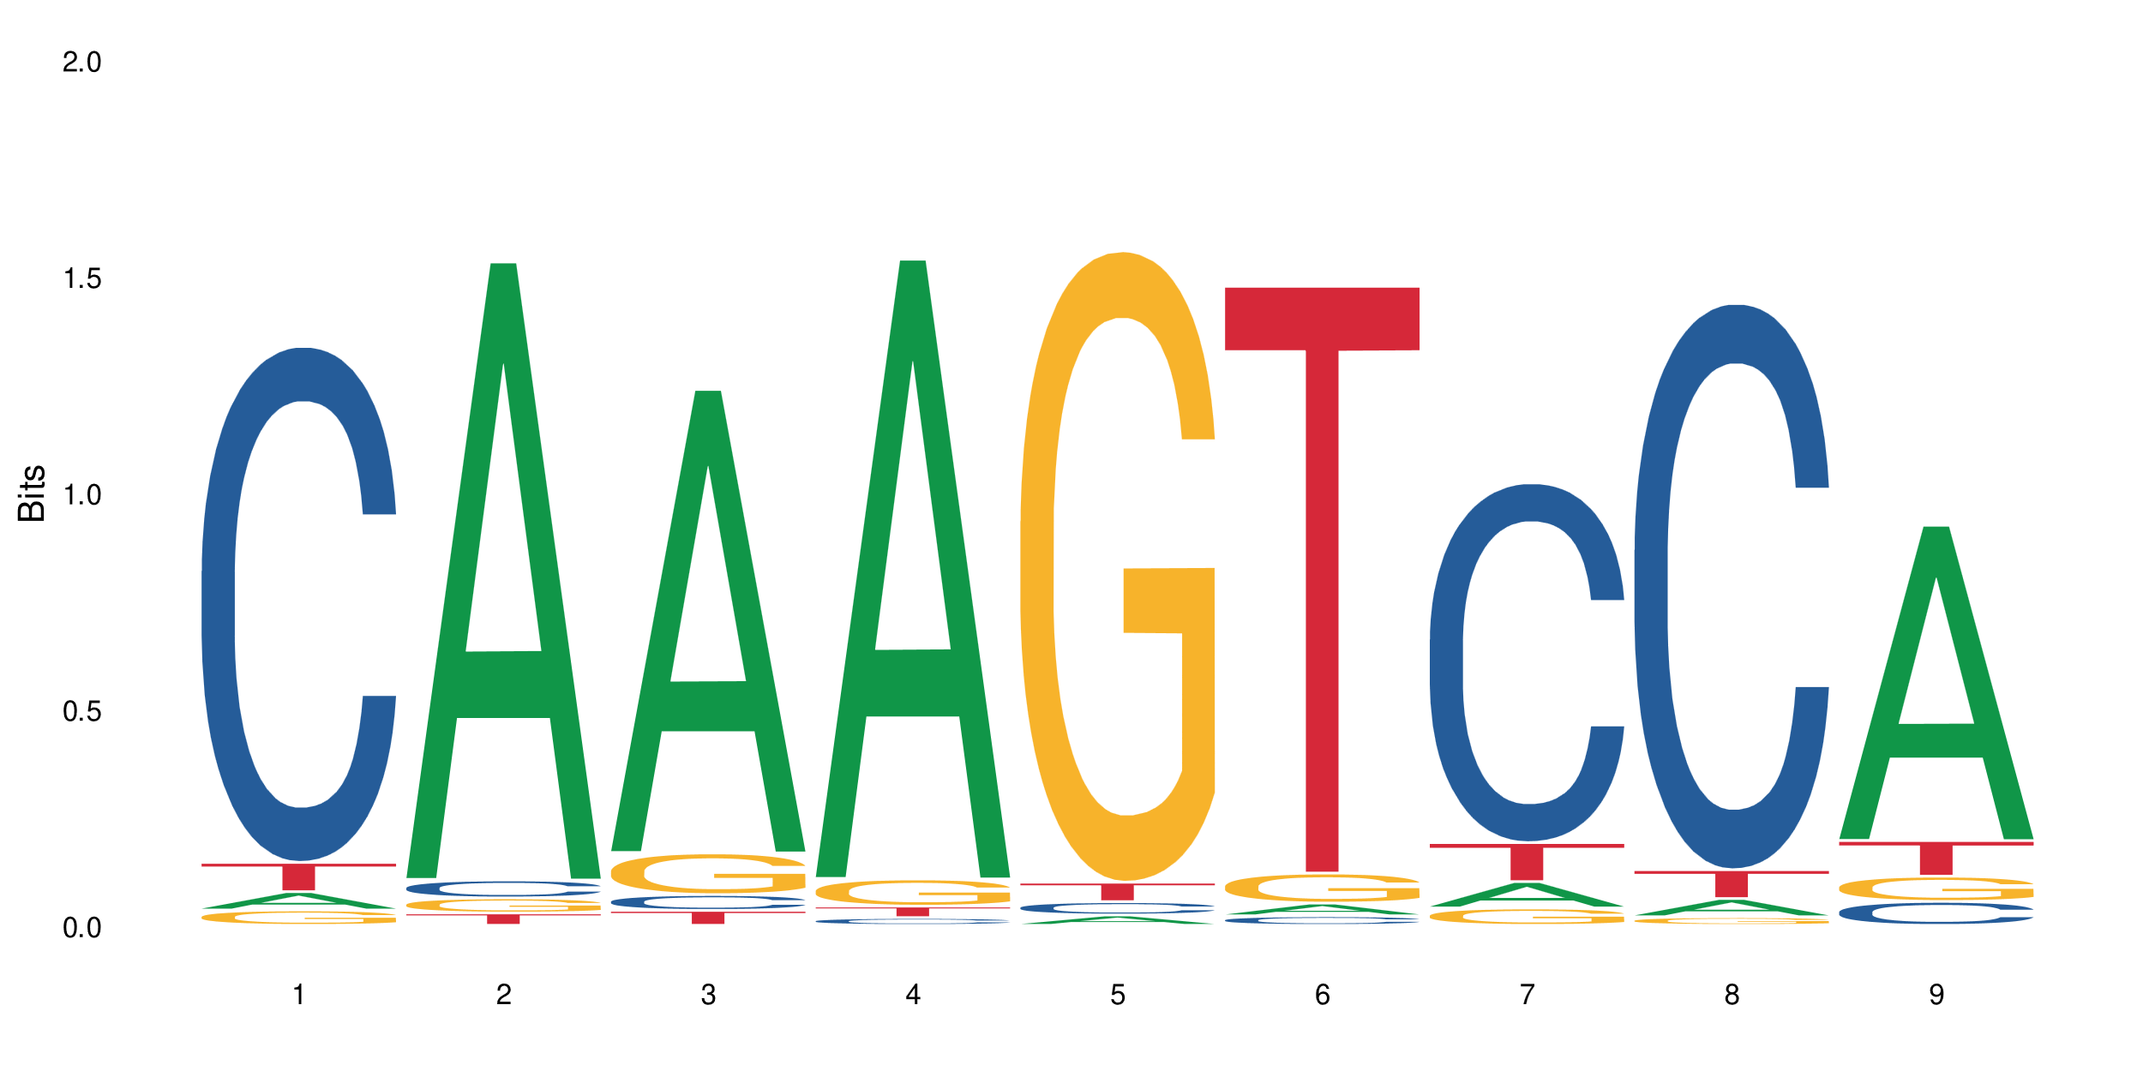
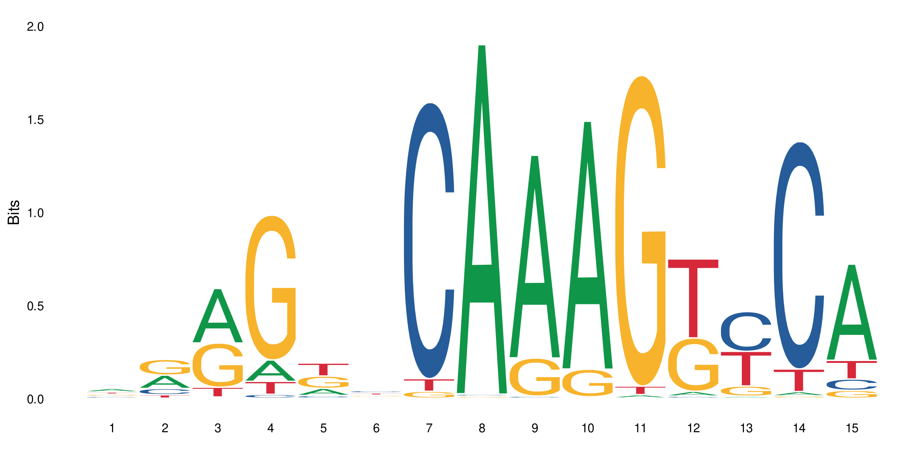
Assigning Transcription Factors to individual Footprints
R>>0; FDR <0.05
R~0
Condition 1
Condition 2
Condition N
TF1 RNA
TF2 RNA
Individuals
TF1
Individuals
TF2
Peaks
Peaks
Peaks
TF1
TF2
TF1 Footprints
+
TF1 Footprints
++
TF1 Footprints
+++
TF2
TF2 Footprints
++
TF2 Footprints
++
TF2 Footprints
+++
TF1
Unpublished data, Yi Lab, 2025
Notes:
Each footprint is tested against all possible TFs from its matching motif.
If a TF’s RNA strongly correlates with the footprint signal (high R, FDR < 0.05), it’s kept as active.
Footprints with weak or no correlation are removed.
This not only removes false or inactive motif matches, but also retains all biologically relevant TFs when multiple show strong correlations.

Slide 12
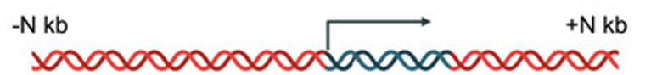
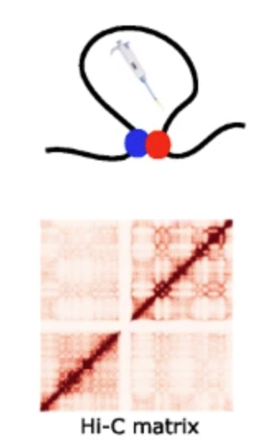

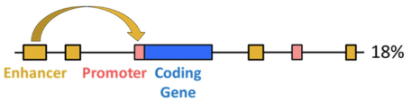
Connecting footprints with target genes
Initial TF → enhancer → gene candidate links
TSS
R>>0|R<<0; FDR <0.05
ATAC
Targeted gene RNA
Targeted gene RNA
GeneA
Individuals
GeneB
Individuals
R~0
GeneA
GeneB
GeneA
GeneB
Notes:
ATAC accessibility is corresponding to the transcription Activity of the enhancers.
After identifying transcription factor footprints, the next question is — which genes do these footprints regulate?
To answer that, we connect footprints to potential target genes using three complementary sources of prior knowledge:
TSS proximity – genes located within about ±30 kb of an open chromatin site (this captures local promoter and nearby enhancer activity).
GeneHancer database – which contains experimentally supported enhancer–gene links from multiple datasets. (~8M)
Hi-C contacts – which provide 3-D genome interaction maps, showing looping connections between distant enhancers and promoters that physically come together. (~ 20K)
These three approaches define our initial TF → enhancer → gene candidate links — what we call regulatory priors.
Then, at the bottom of the slide, we refine these connections using actual data. For each enhancer (or ATAC peak) and its linked gene, we correlate chromatin accessibility (ATAC signal) with the gene’s RNA expression across samples.
If accessibility and expression rise and fall together (high positive correlation or negative correlation), we keep that link.
If there’s no consistent relationship, we drop it.
This makes the final network data-driven, not just based on static annotations — ensuring that only enhancers actively linked to gene regulation in our system are retained.

Slide 13
Connecting footprints with target genes
R>>0|R<<0; FDR <0.05
Peaks
Motifs
Footprints
+++
+
+++
Targeted gene RNA
Individuals
GeneA
Individuals
Peaks
GeneA
Motifs
Footprints
+
++
++
GeneA
R~0
Peaks
Motifs
Footprints
+
+++
+
Unpublished data, Yi Lab, 2025
Notes:
After we link footprints to potential enhancer regions, the next step is to see which genes they actually regulate.
Here, we correlate footprint score — how open that site is across samples — with the RNA expression of target genes. If both move together (high correlation), that footprint is likely driving that gene’s expression. If there’s no correlation, we discard that link.
This step filters out random or inactive footprints, leaving only those functionally connected to gene activity — making our network much more specific and data-driven.

Slide 14
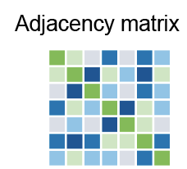
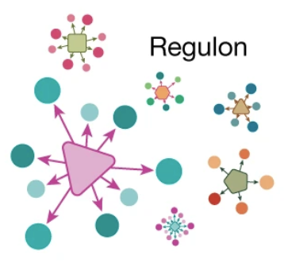
Building transcription factor regulons
Contains
Basal gene regulatory network
TF
ATAC
R>>0; FDR <0.05
R>>0|R<<0; FDR <0.05
Footprints
Target genes
R>>0|R<<0; FDR <0.05
Unpublished data, Yi Lab, 2025
Notes:
At this stage, we combine all layers — TFs, footprints, and target genes — using matched RNA and ATAC data.
We calculate three-way correlations: TF expression ↔ footprint accessibility, footprint ↔ target gene expression, and TF ↔ gene through the shared footprint link.
Only strong and significant correlations are kept, forming directed TF → gene connections. All these links are then saved as an adjacency matrix, which we can visualize as regulons — each TF and its connected target genes. Or networks

Slide 15
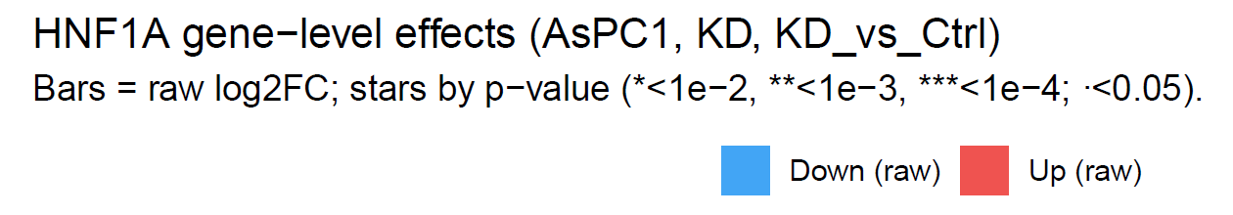
Validate Episcope TF-regulon predictions with published RNAseq data
Unpublished data, Yi Lab, 2025

Slide 16
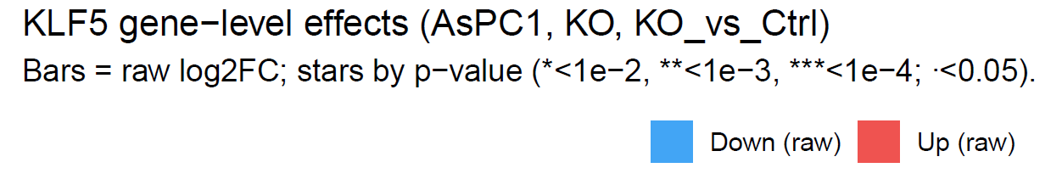
Validate Episcope TF-regulon predictions with published RNAseq data
Unpublished data, Yi Lab, 2025

Slide 17
Validate Episcope TF-regulon predictions with published RNAseq data
Unpublished data, Yi Lab, 2025

Slide 18
Validate Episcope TF-regulon predictions with published RNAseq data
Unpublished data, Yi Lab, 2025

Slide 19
Validate Episcope TF-regulon predictions with published RNAseq data
Unpublished data, Yi Lab, 2025

Slide 20
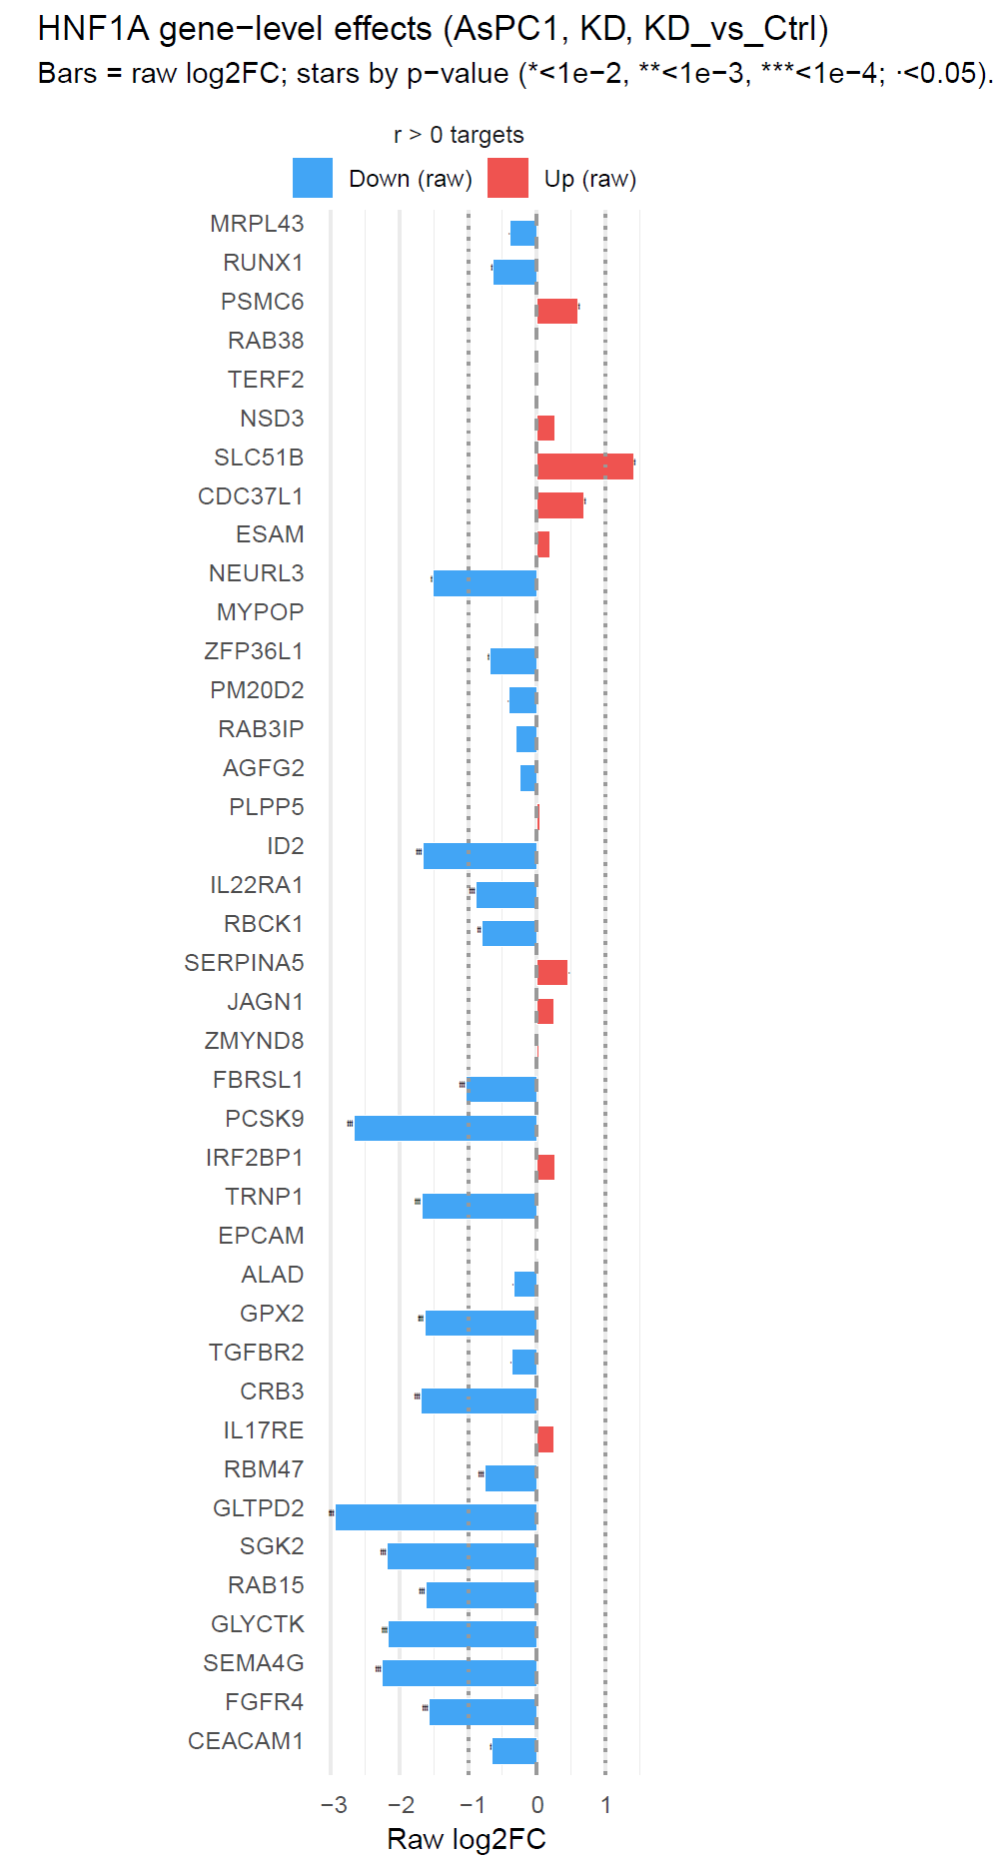
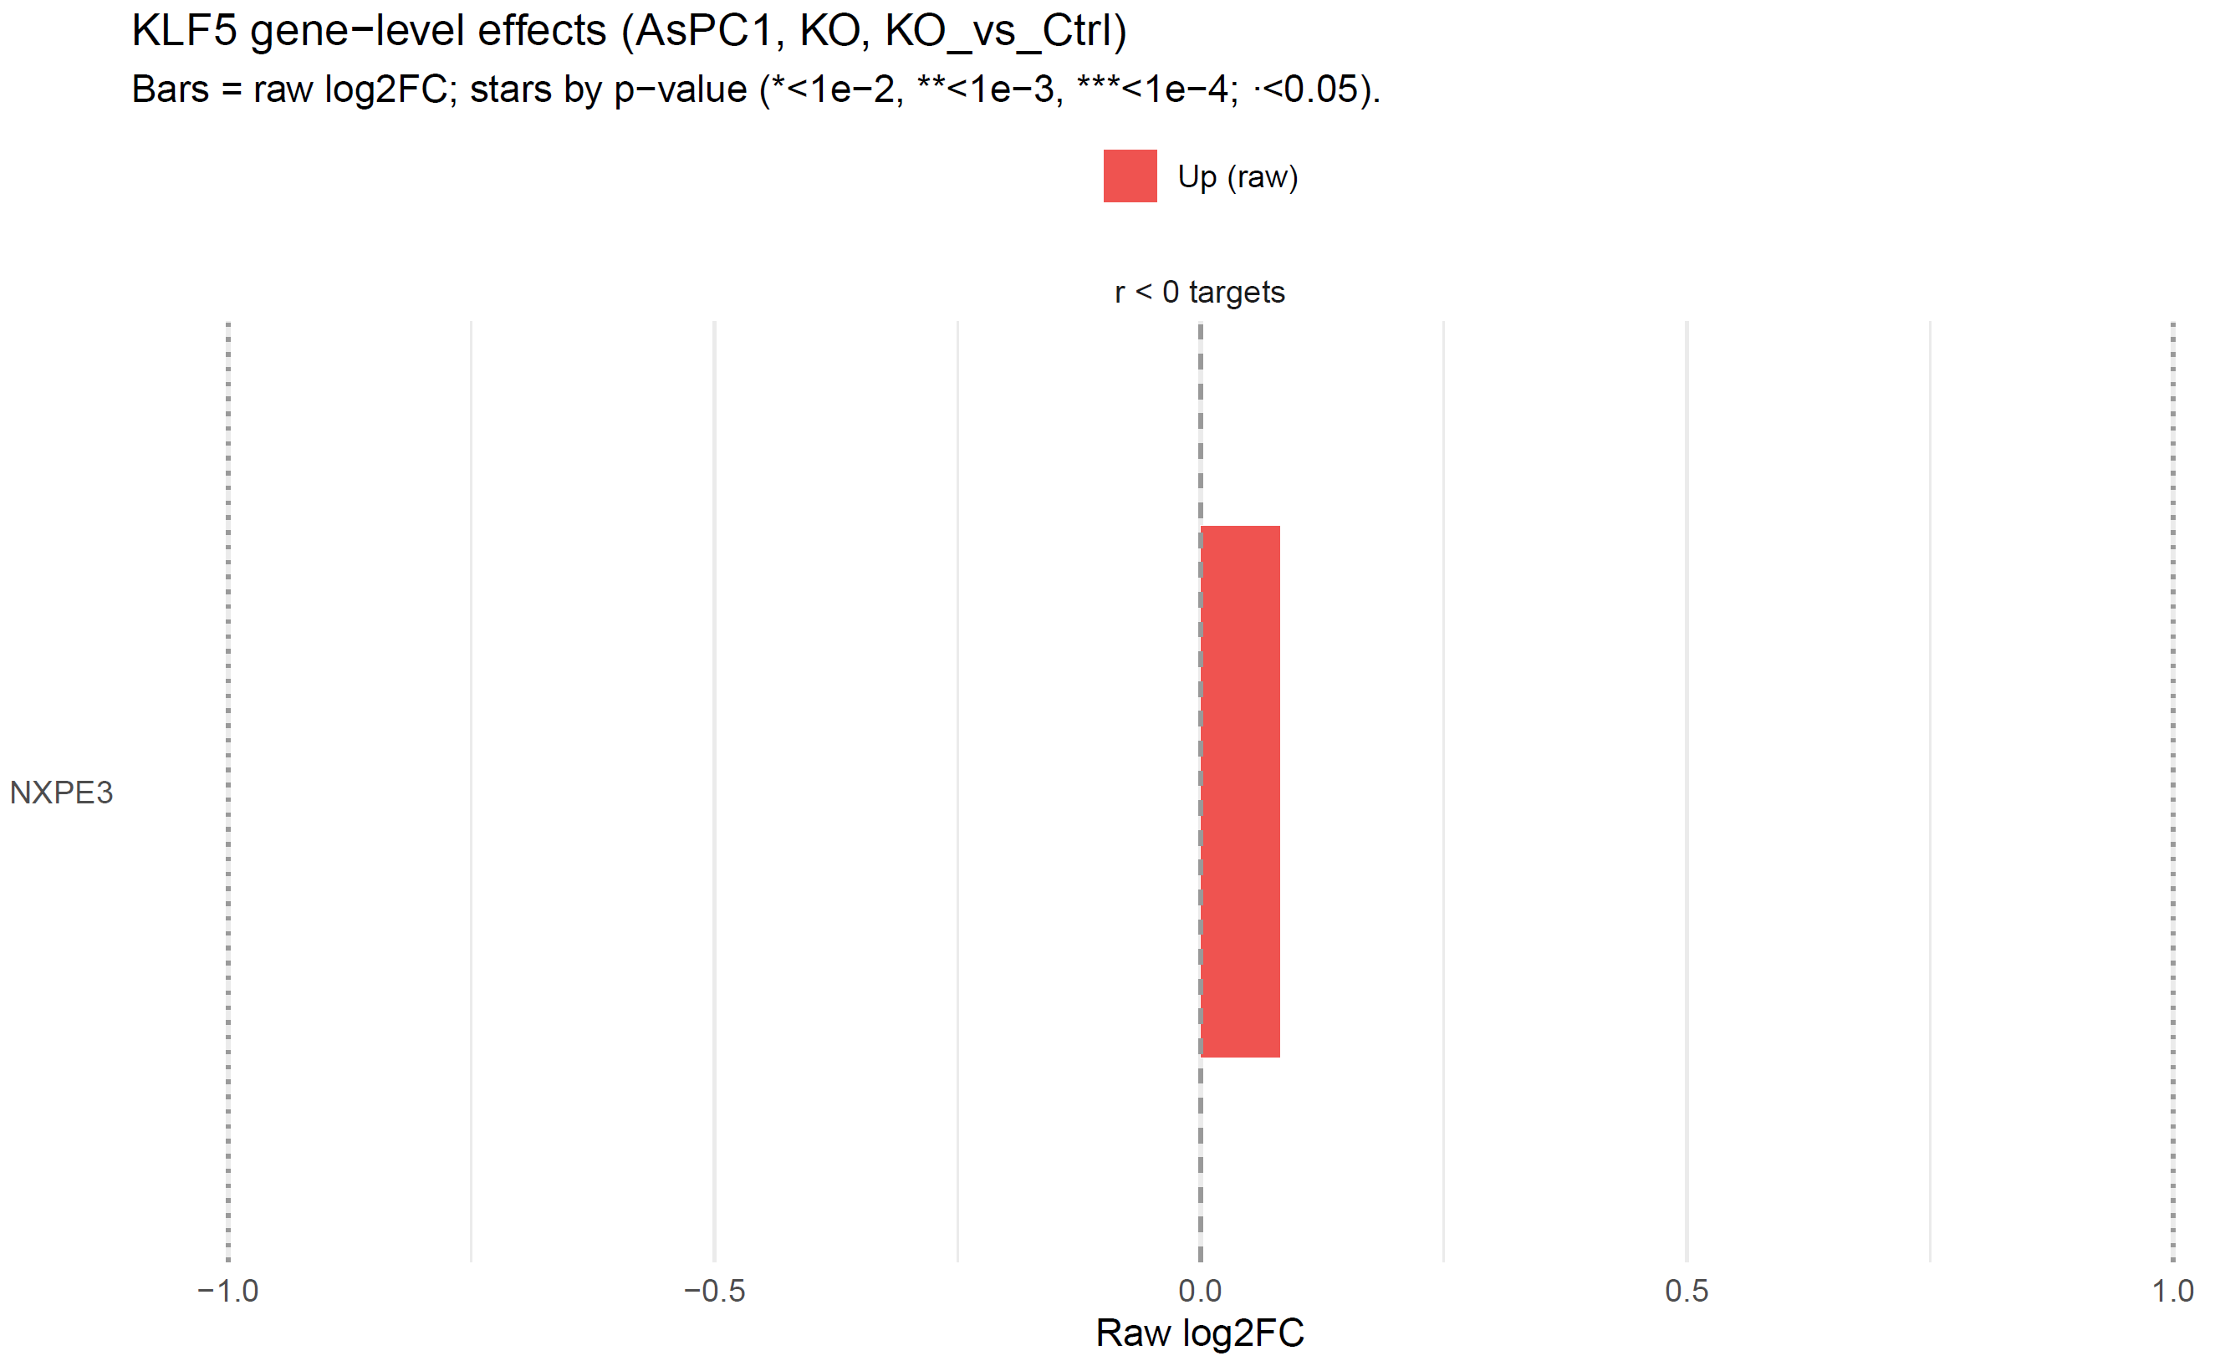
Results from GRaNIE
Unpublished data, Yi Lab, 2025

Slide 21
Condition-Specific and Differential GRNs
GRN - Condition A
GRN - Condition B vs. A
GRN - Condition B
Unpublished data, Yi Lab, 2025
Notes:
how we first “light up” the basal GRN under each condition — by overlaying RNA-seq and ATAC-seq signals onto the same regulatory map.
For each condition, active links (TF→gene) are highlighted based on footprint strength and RNA correlation, showing which parts of the network are turned on.
Then, by comparing two conditions (e.g. nutrient stress vs. control), we build a differential network, where edge direction and color show activation or repression changes. Node size and color reflect expression level, and border color marks log₂ fold change — revealing how regulatory wiring shifts between conditions.

Slide 22
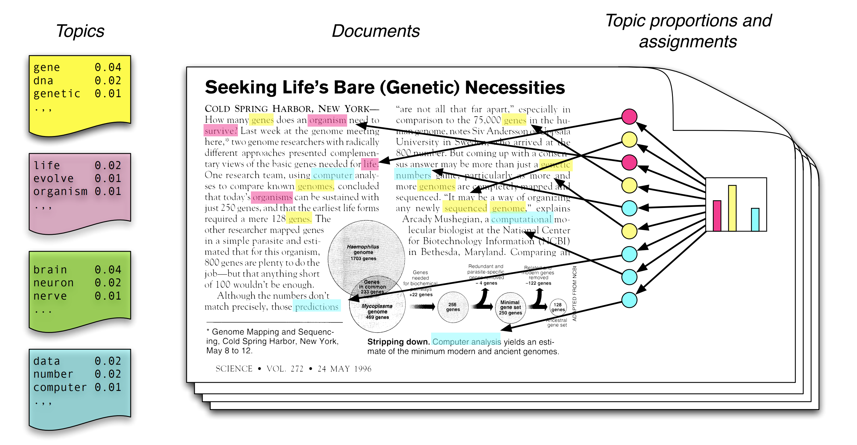
Latent Dirichlet allocation (LDA) Topic Modeling
LDA discovers latent themes shared across documents
GRN - Condition B vs. A
Topic
Modelling
Cluster of Word by Topic
Collection of
Text Documents
Cluster of Document by Topic
Transcription factors (TF)
1
2
3
4
5
6
85
Latent topics
1
2
3
4
9
A
B
C
D
E
F
G
H
I
J
K
L
Target genes
Source: Introduction to Probabilistic Topic Models paper by Blei et. al
Unpublished data, Yi Lab, 2025
Notes:
Here we use topic modeling (LDA) — a method originally used to find themes in text — to uncover hidden regulatory programs in our differential GRN. Each TF is treated like a “document,” and its target genes are like “words.” LDA groups TFs that share similar gene targets into latent topics, revealing coordinated regulatory modules that act together under specific conditions.

Slide 23
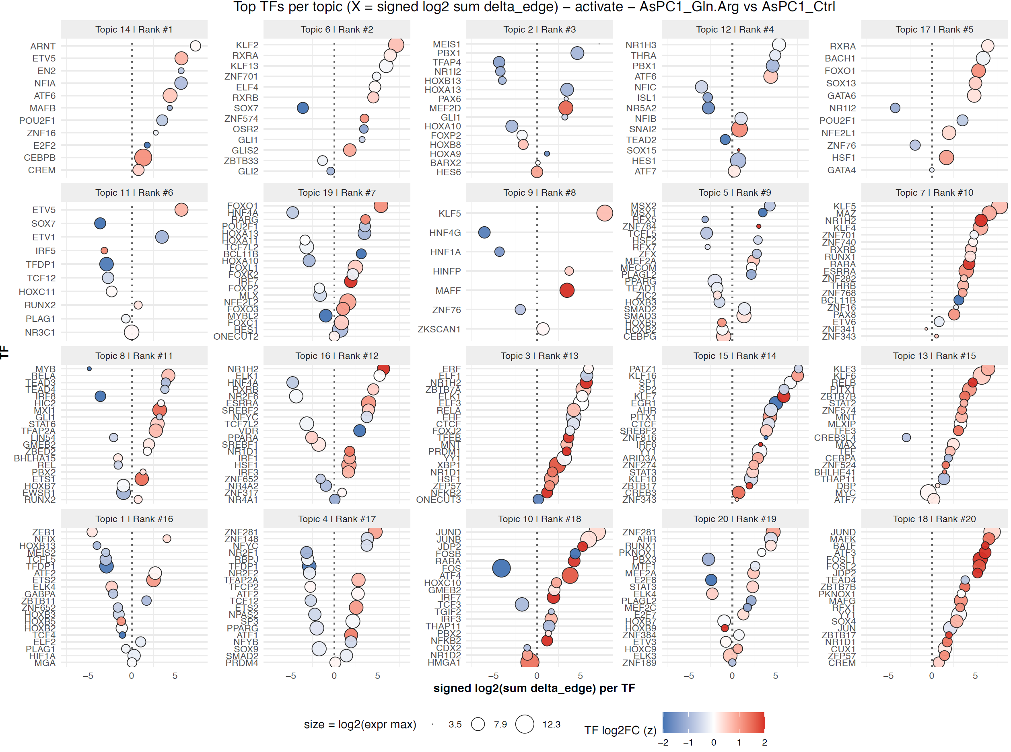
Latent Dirichlet allocation (LDA) Topic Modeling
AsPC1 Gln.Arg vs. Ctrl
EMT / developmental and plasticity factors:
SOX9, HOXC11, RUNX2, FOXQ1, ZEB1, HOXA/B, PBX1, MEIS1/2
Unpublished data, Yi Lab, 2025
Notes:
Here, we applied LDA topic modeling to the differential GRN between AsPC1 Gln/Arg vs. control. Each topic groups transcription factors that co-regulate similar target genes. We see distinct biological programs emerging — • EMT and developmental factors driving plasticity (red box), • Nuclear receptors mediating lipid and hormone signaling (green), • ATF4- and NRF2-linked stress pathways under amino-acid deprivation (purple), and • Cell-cycle and chromatin factors showing activation under stress (blue). Together, these topics reveal coordinated regulatory modules underlying nutrient-specific transcriptional responses.
The ER (Endoplasmic Reticulum) is where proteins are folded and processed. When cells are under stress — like nutrient deprivation — misfolded proteins accumulate, triggering the Unfolded Protein Response (UPR). The UPR (mainly regulated by ATF4, XBP1, DDIT3/CHOP) helps restore protein-folding balance or, if stress persists, drives apoptosis.
ER-UPR refers to the cell’s stress-response pathway that maintains protein-folding homeostasis under nutrient or oxidative stress.

Slide 24
Latent Dirichlet allocation (LDA) Topic Modeling
AsPC1 Gln.Arg vs. Ctrl
Hormonal and nuclear receptor regulation:
NR1H3 (LXRα), RXRA, NR5A2, THRA, PPARG, RARA
EMT / developmental and plasticity factors:
SOX9, HOXC11, RUNX2, FOXQ1, ZEB1, HOXA/B, PBX1, MEIS1/2
Unpublished data, Yi Lab, 2025
Notes:
Here, we applied LDA topic modeling to the differential GRN between AsPC1 Gln/Arg vs. control. Each topic groups transcription factors that co-regulate similar target genes. We see distinct biological programs emerging — • EMT and developmental factors driving plasticity (red box), • Nuclear receptors mediating lipid and hormone signaling (green), • ATF4- and NRF2-linked stress pathways under amino-acid deprivation (purple), and • Cell-cycle and chromatin factors showing activation under stress (blue). Together, these topics reveal coordinated regulatory modules underlying nutrient-specific transcriptional responses.
The ER (Endoplasmic Reticulum) is where proteins are folded and processed. When cells are under stress — like nutrient deprivation — misfolded proteins accumulate, triggering the Unfolded Protein Response (UPR). The UPR (mainly regulated by ATF4, XBP1, DDIT3/CHOP) helps restore protein-folding balance or, if stress persists, drives apoptosis.
ER-UPR refers to the cell’s stress-response pathway that maintains protein-folding homeostasis under nutrient or oxidative stress.

Slide 25
Latent Dirichlet allocation (LDA) Topic Modeling
AsPC1 Gln.Arg vs. Ctrl
Hormonal and nuclear receptor regulation:
NR1H3 (LXRα), RXRA, NR5A2, THRA, PPARG, RARA
EMT / developmental and plasticity factors:
SOX9, HOXC11, RUNX2, FOXQ1, ZEB1, HOXA/B, PBX1, MEIS1/2
Stress-response & ER/UPR programs:
NRF2, ATF4, DDIT3, XBP1, MAFF, JUND
Unpublished data, Yi Lab, 2025
Notes:
Here, we applied LDA topic modeling to the differential GRN between AsPC1 Gln/Arg vs. control. Each topic groups transcription factors that co-regulate similar target genes. We see distinct biological programs emerging — • EMT and developmental factors driving plasticity (red box), • Nuclear receptors mediating lipid and hormone signaling (green), • ATF4- and NRF2-linked stress pathways under amino-acid deprivation (purple), and • Cell-cycle and chromatin factors showing activation under stress (blue). Together, these topics reveal coordinated regulatory modules underlying nutrient-specific transcriptional responses.
The ER (Endoplasmic Reticulum) is where proteins are folded and processed. When cells are under stress — like nutrient deprivation — misfolded proteins accumulate, triggering the Unfolded Protein Response (UPR). The UPR (mainly regulated by ATF4, XBP1, DDIT3/CHOP) helps restore protein-folding balance or, if stress persists, drives apoptosis.
ER-UPR refers to the cell’s stress-response pathway that maintains protein-folding homeostasis under nutrient or oxidative stress.

Slide 26
Latent Dirichlet allocation (LDA) Topic Modeling
AsPC1 Gln.Arg vs. Ctrl
Hormonal and nuclear receptor regulation:
NR1H3 (LXRα), RXRA, NR5A2, THRA, PPARG, RARA
EMT / developmental and plasticity factors:
SOX9, HOXC11, RUNX2, FOXQ1, ZEB1, HOXA/B, PBX1, MEIS1/2
Stress-response & ER/UPR programs:
NRF2, ATF4, DDIT3, XBP1, MAFF, JUND
Proliferation & chromatin regulators:
E2F, MYBL2, FOXM1, BACH1
Unpublished data, Yi Lab, 2025
Notes:
Here, we applied LDA topic modeling to the differential GRN between AsPC1 Gln/Arg vs. control. Each topic groups transcription factors that co-regulate similar target genes. We see distinct biological programs emerging — • EMT and developmental factors driving plasticity (red box), • Nuclear receptors mediating lipid and hormone signaling (green), • ATF4- and NRF2-linked stress pathways under amino-acid deprivation (purple), and • Cell-cycle and chromatin factors showing activation under stress (blue). Together, these topics reveal coordinated regulatory modules underlying nutrient-specific transcriptional responses.
The ER (Endoplasmic Reticulum) is where proteins are folded and processed. When cells are under stress — like nutrient deprivation — misfolded proteins accumulate, triggering the Unfolded Protein Response (UPR). The UPR (mainly regulated by ATF4, XBP1, DDIT3/CHOP) helps restore protein-folding balance or, if stress persists, drives apoptosis.
ER-UPR refers to the cell’s stress-response pathway that maintains protein-folding homeostasis under nutrient or oxidative stress.

Slide 27
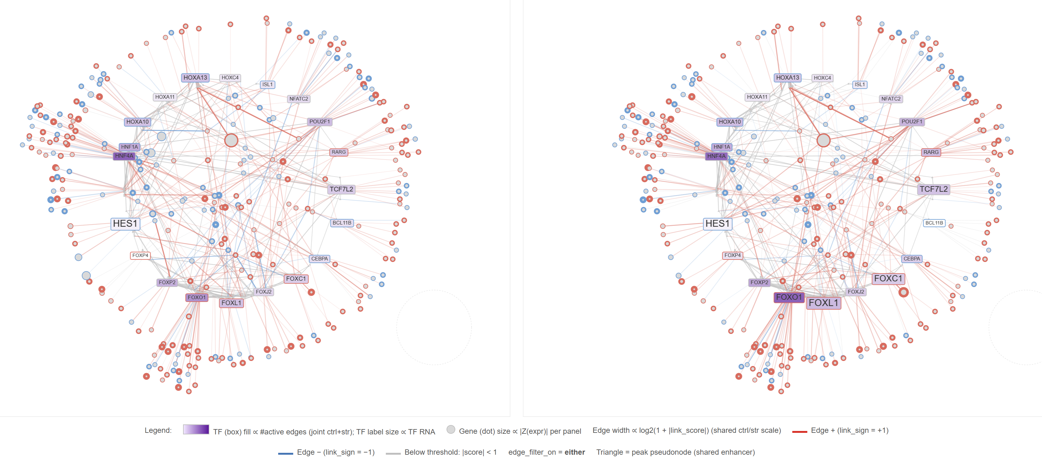
AsPC1 Gln.Arg vs Ctrl | Topic 19 [rank 7] – pairwise network
Unpublished data, Yi Lab, 2025

Slide 28
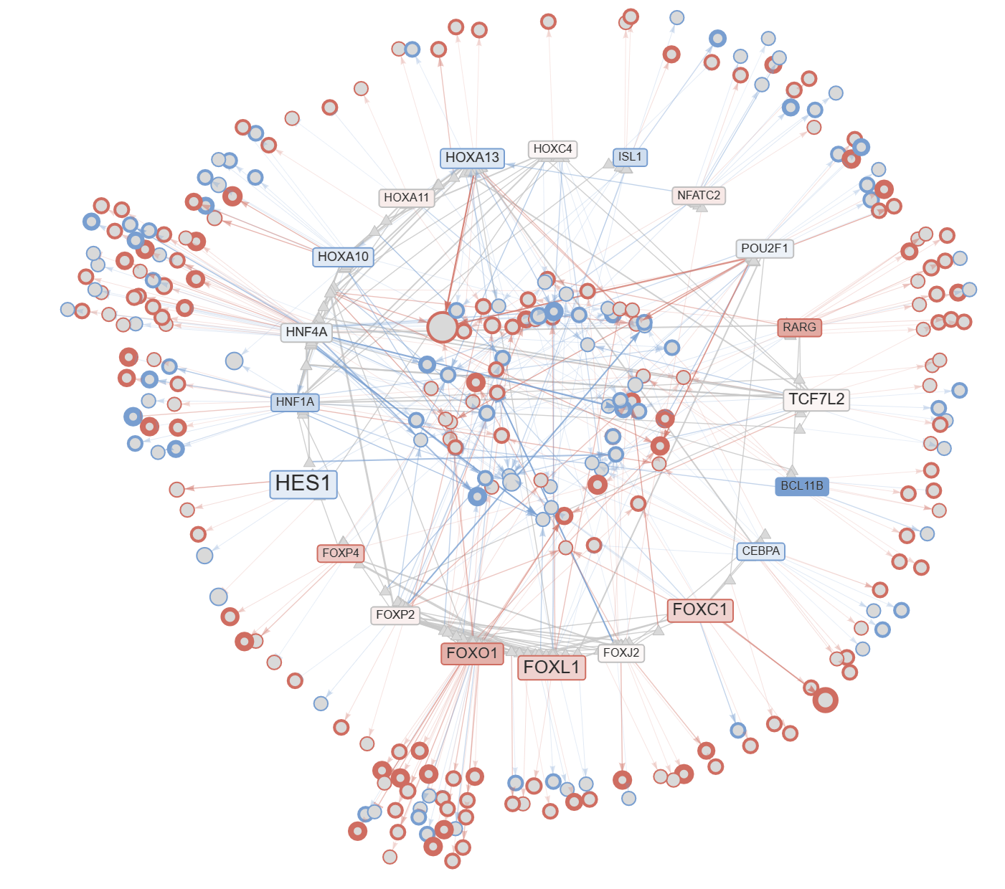

AsPC1 Gln.Arg vs Ctrl | Topic 19 [rank 7] – Δ network
Unpublished data, Yi Lab, 2025
Notes:
file:///C:/Users/Workstation/Box/Yaoxiang/presentations/20251103-supp-files/AsPC1_Gln.Arg_vs_AsPC1_Ctrl_delta_links_filtered_lda_K20_topic-19_rank-07_subnetwork_delta.html
AsPC1 Gln/Arg deprivation, Topic 19 captures a strong developmental and EMT-like network, centered on FOXC1, FOXL1, and HNF4A, together with HOX-family and RARG nodes. These TFs are known for controlling epithelial differentiation and plasticity, showing activation of cell-state remodeling under amino-acid stress.

Slide 29
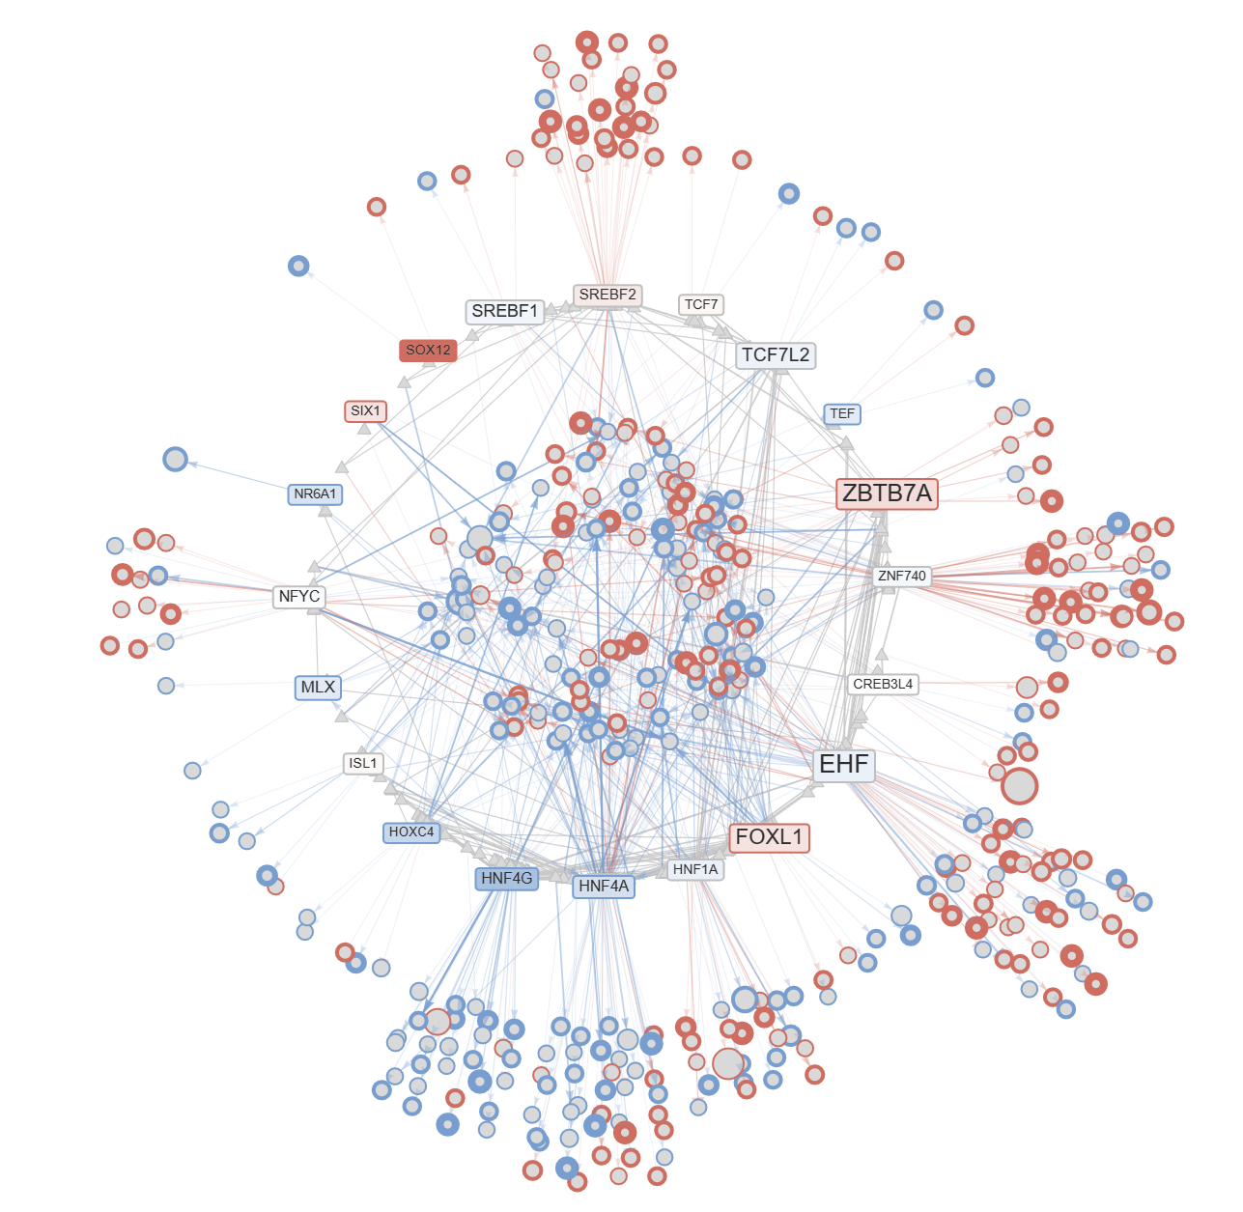
AsPC1 Glc vs Ctrl | Topic 9 [rank 6] – Δ network
Unpublished data, Yi Lab, 2025
Notes:
file:///C:/Users/Workstation/Box/Yaoxiang/presentations/20251103-supp-files/AsPC1_Glc_vs_AsPC1_Ctrl_delta_links_filtered_lda_K20_topic-9_rank-06_subnetwork_delta.html
AsPC1 Glucose deprivation, Topic 9 highlights a metabolic-regulatory network, driven by EHF, SREBF1/2, and HNF4A, coupled with chromatin regulators such as ZBTB7A and CREB3L4. This reflects adaptive reprogramming of lipid and redox metabolism during glucose stress.
Together, these Δ-networks show that different nutrient stresses activate distinct TF modules — one more developmental (EMT-like) and one more metabolic (ER/lipid response) — consistent with the topic model’s ability to separate underlying regulatory themes.

Slide 30
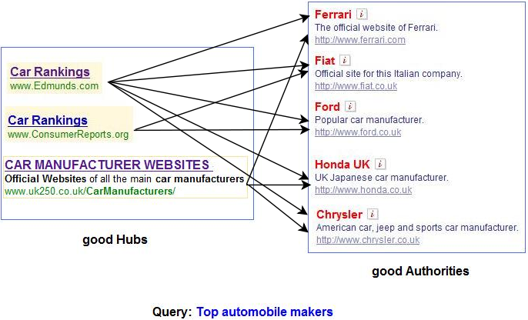
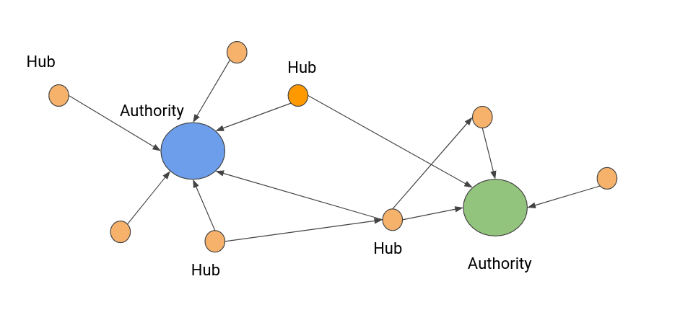
Predict essential TF via Hyperlink-Induced Topic Search (HITS)
Unpublished data, Yi Lab, 2025
Notes:
In the same way search engines find pages that are good directories (hubs) and good content sources (authorities), we use the HITS logic on our regulatory network to find TFs that act as broad regulators (hubs) feeding into many well-regulated target modules (authorities). Those TFs with high hub scores are our top candidates for essential regulators in PDAC under nutrient stress.

Slide 31
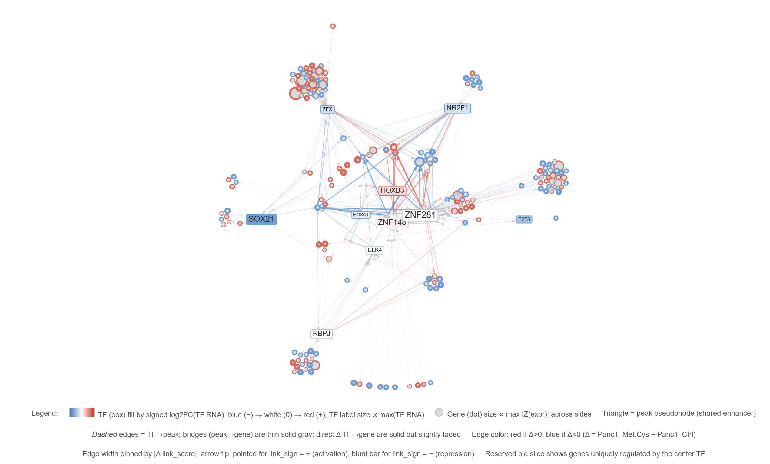
Panc1_Met.Cys_vs_Panc1_Ctrl | TF hub Δ-links: ZNF148
Notes:
After identifying the transcription factor hubs from the differential GRN analysis, we visualize each hub’s local network — in this case, ZNF148 and ZNF281 under methionine/cysteine stress in Panc1 cells. Each node here represents a gene, and each edge represents a regulatory connection (TF → gene) whose strength changes between stress and control.
Red edges/nodes indicate gained activation under stress, while blue indicate loss or repression.
Edge width reflects the strength of regulatory change (Δlink score).
Boxed TFs show key regulators, with fill color showing RNA expression change. We can see that ZNF281 and ZNF148 form a co-regulatory hub with shared targets and links to other developmental and stress-related TFs (like HOX, SOX, NR2F, ATF6). Together, these hubs illustrate how nutrient stress reconfigures transcriptional control around specific TFs.

Slide 32
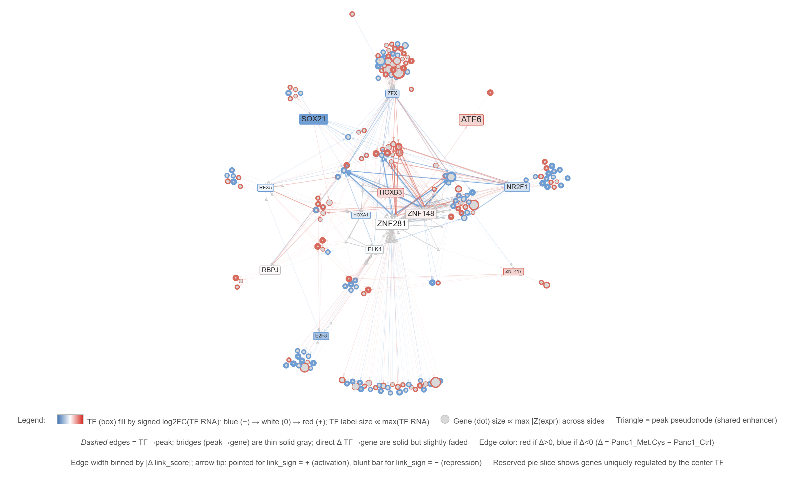
Panc1_Met.Cys_vs_Panc1_Ctrl | TF hub Δ-links: ZNF281
Notes:
After identifying the transcription factor hubs from the differential GRN analysis, we visualize each hub’s local network — in this case, ZNF148 and ZNF281 under methionine/cysteine stress in Panc1 cells. Each node here represents a gene, and each edge represents a regulatory connection (TF → gene) whose strength changes between stress and control.
Red edges/nodes indicate gained activation under stress, while blue indicate loss or repression.
Edge width reflects the strength of regulatory change (Δlink score).
Boxed TFs show key regulators, with fill color showing RNA expression change. We can see that ZNF281 and ZNF148 form a co-regulatory hub with shared targets and links to other developmental and stress-related TFs (like HOX, SOX, NR2F, ATF6). Together, these hubs illustrate how nutrient stress reconfigures transcriptional control around specific TFs.

Slide 33
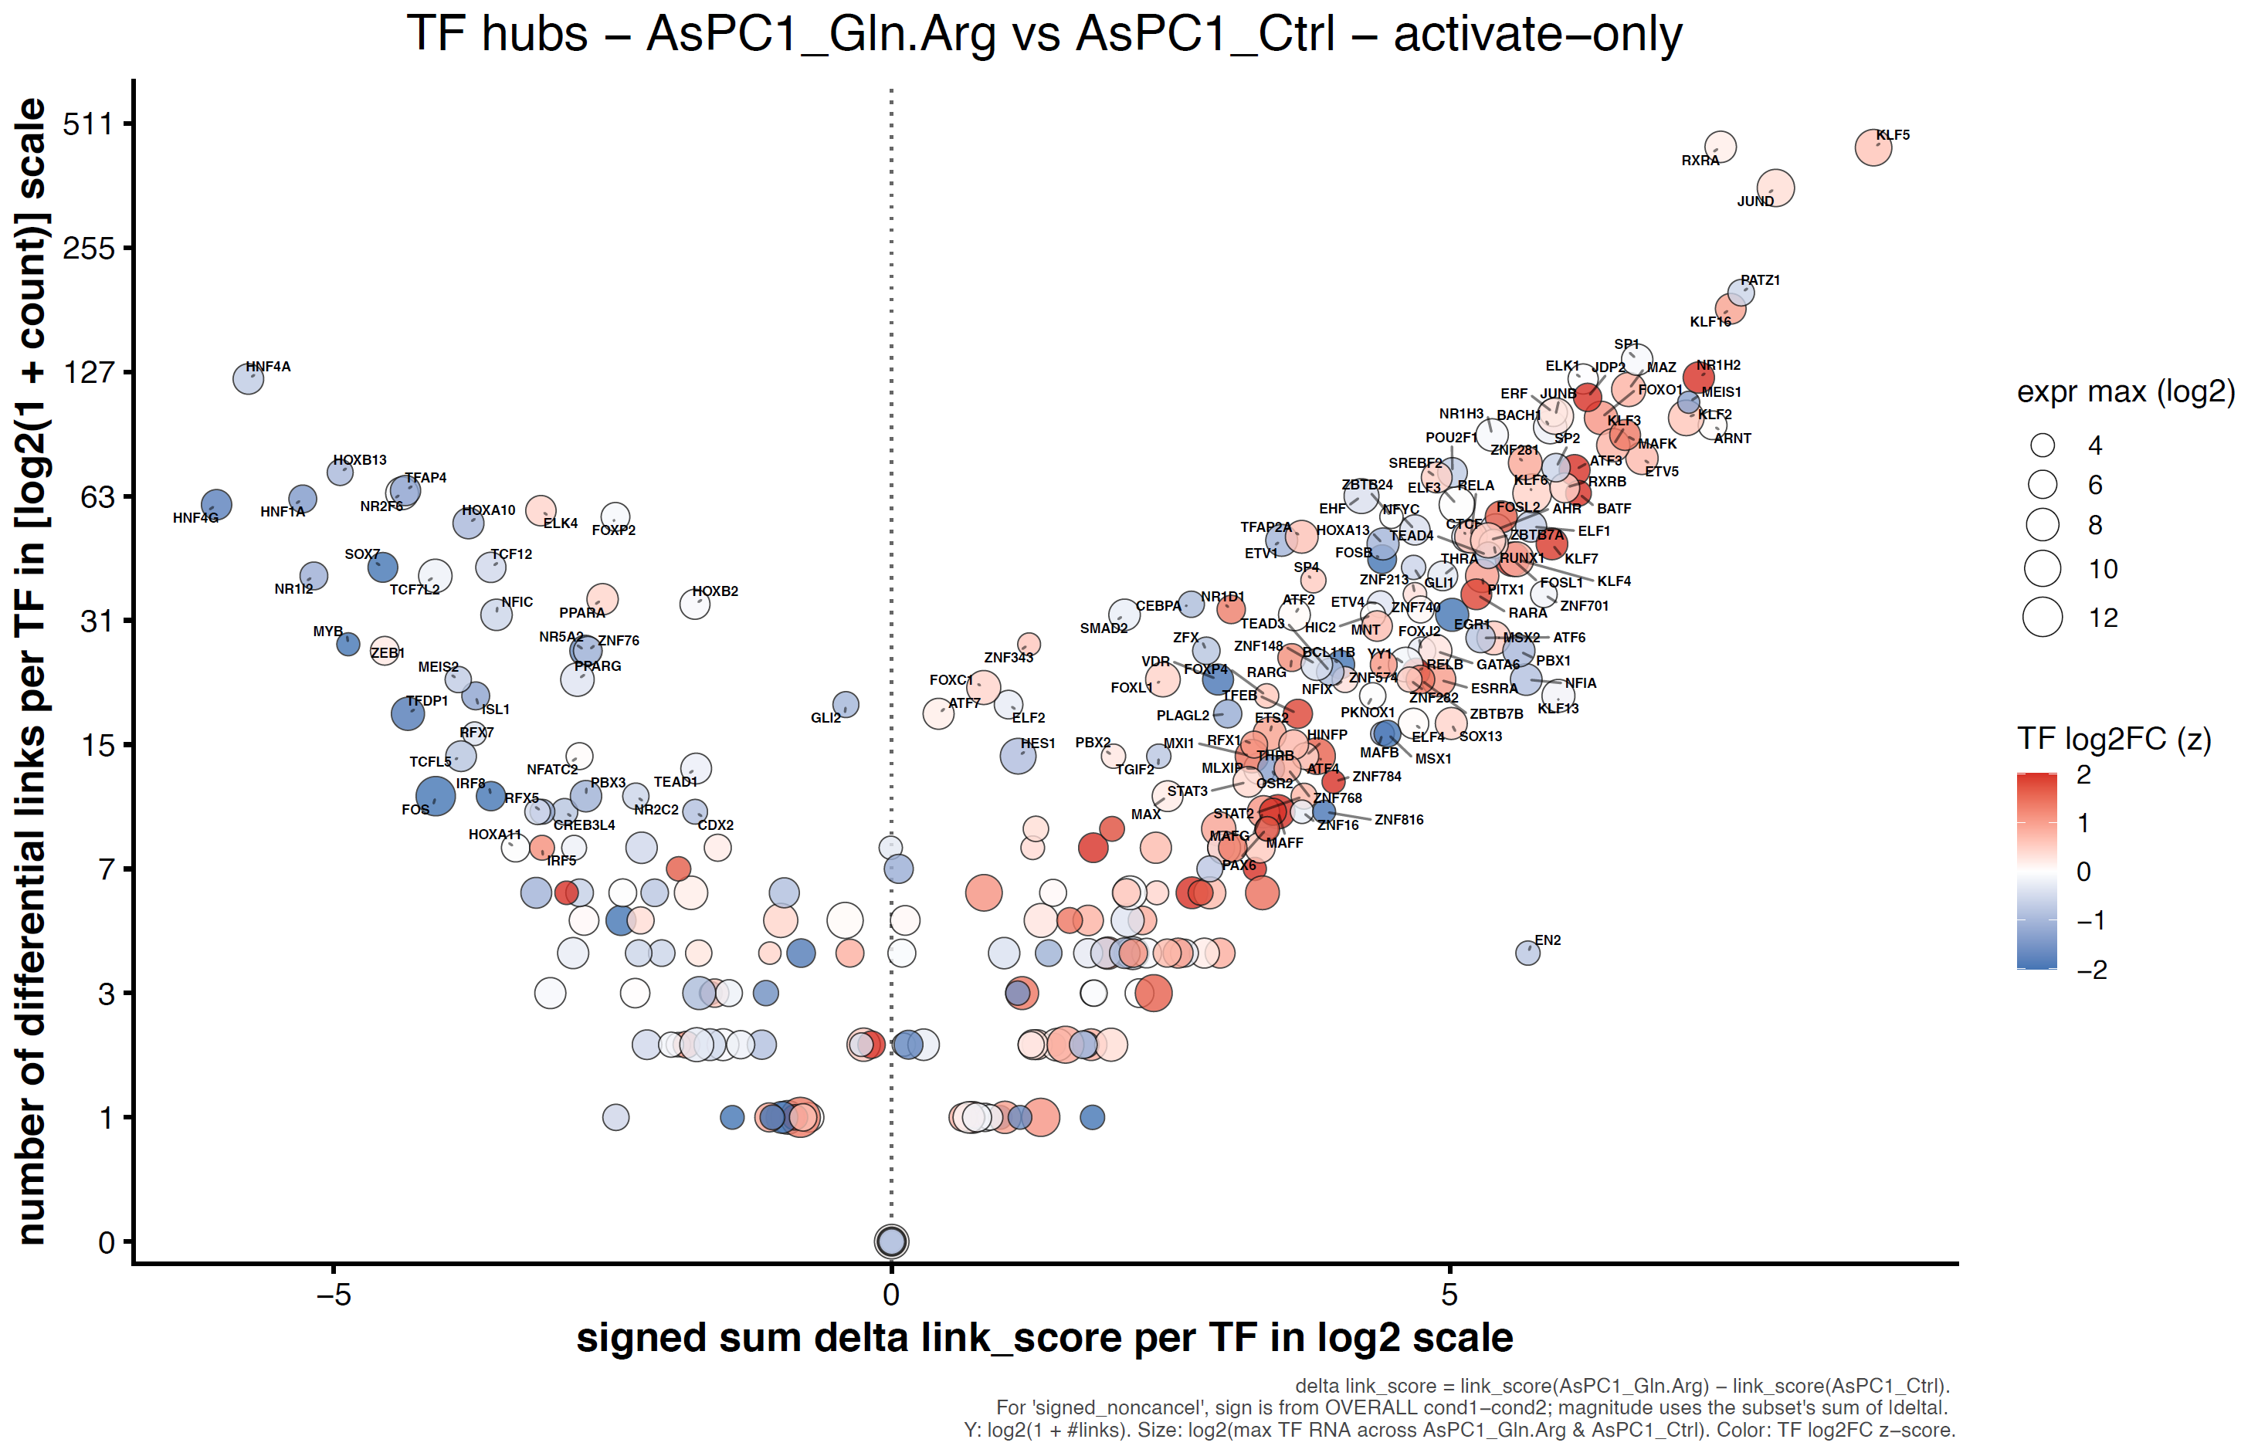
TF-regulon activity summary
Unpublished data, Yi Lab, 2025
Notes:
This summarizes TF-regulon activity. On the X-axis, we have the signed sum of differential link scores — showing whether a TF gains or loses regulatory connections under Gln/Arg stress compared to control. The Y-axis shows the number of differential links per TF, reflecting how broad that change is. Bubble size represents overall TF expression, and color shows log2 fold-change — red for upregulated, blue for down.”

Slide 34
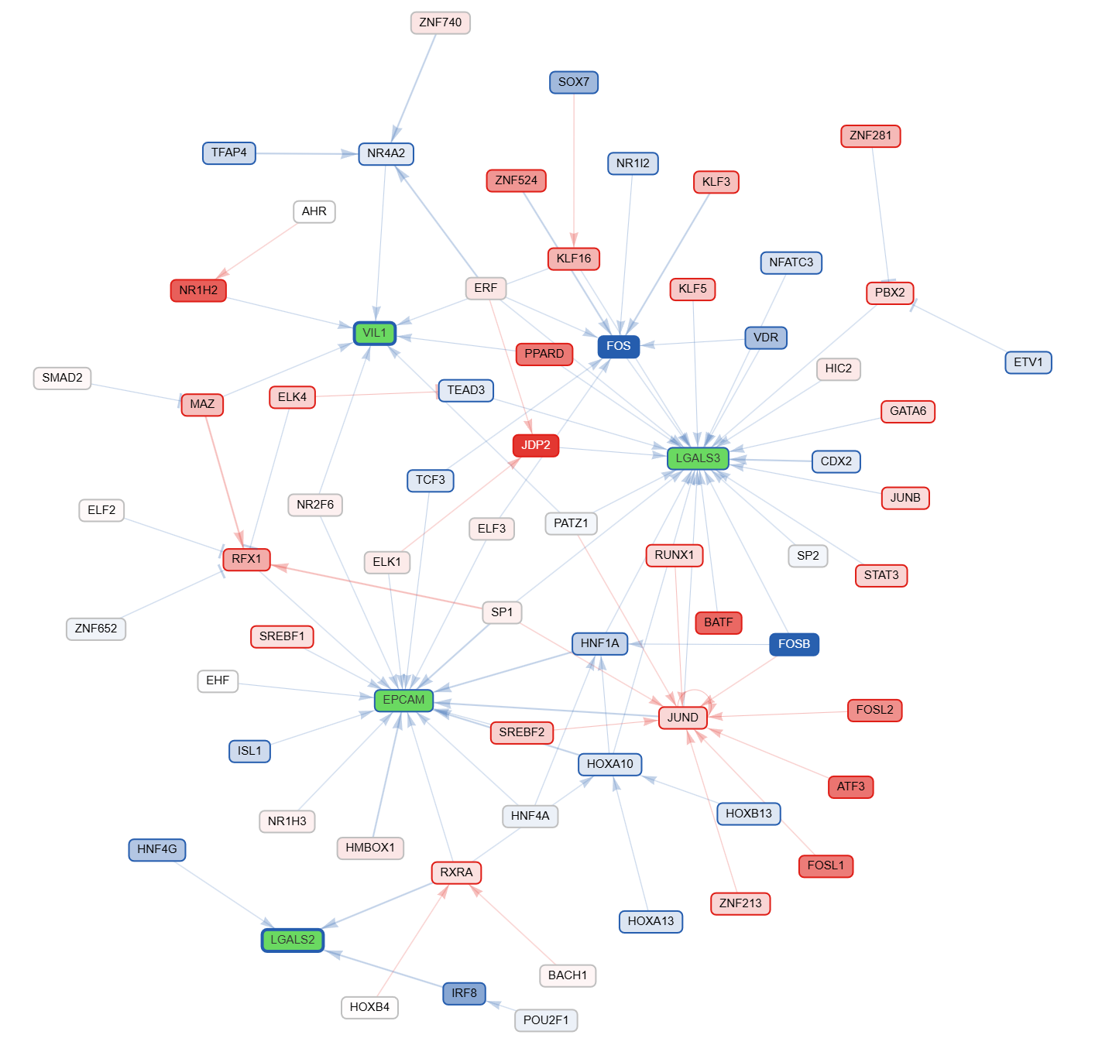
Visualization of epithelial targets under nutrient stress
AsPC1 Gln.Arg vs. Ctrl
Unpublished data, Yi Lab, 2025
Notes:
AsPC1_Gln.Arg_lighting_lenient_EPCAM.LGALS2.LGALS3.LGALS4.VIL1_jaspar2024_regulated_genes_1.5_delta_link_1 | Δ-network

Slide 35
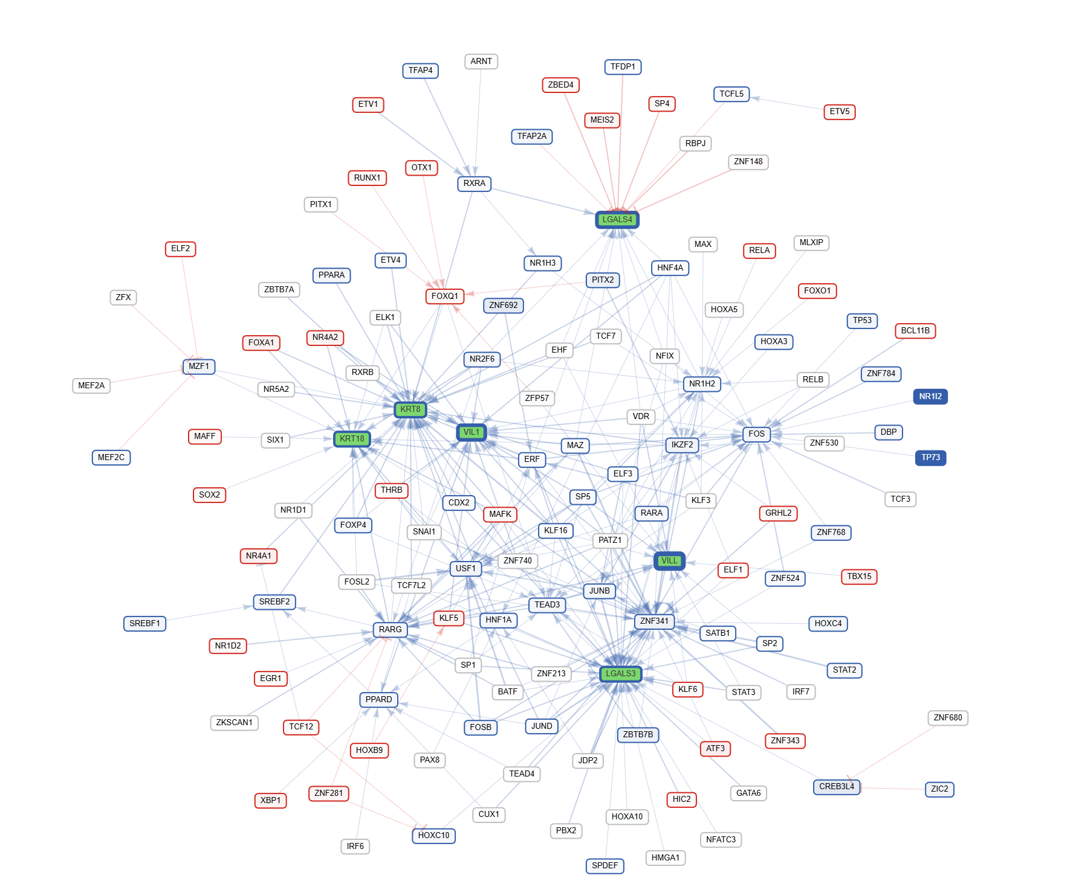
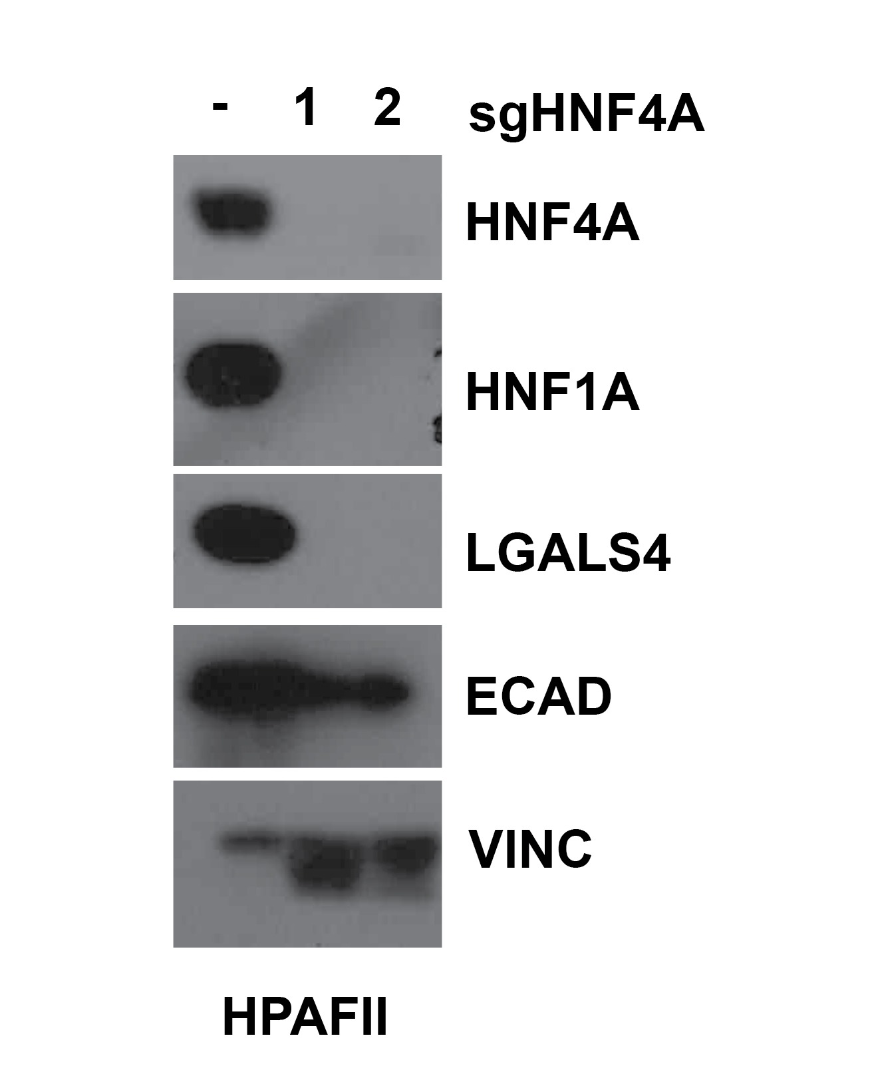
Visualization of epithelial targets under nutrient stress
HPAFII Gln.Arg vs. Ctrl
HPAFII - HNF4A - KO validation
Notes:
HPAFII_Gln.Arg_lighting_lenient_LGALS3.LGALS4.VIL1.VILL.KRT8.KRT18_jaspar2024_regulated_genes_2_delta_link_1 | Δ-network

Slide 36
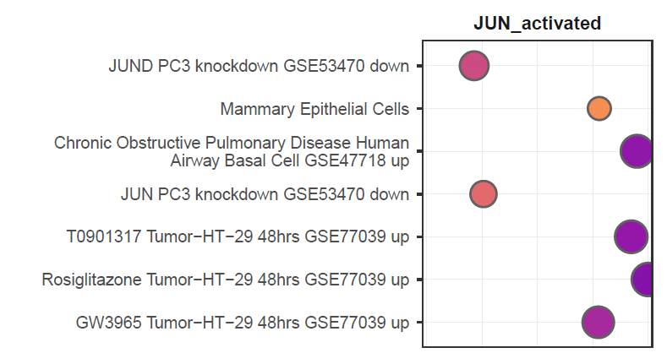
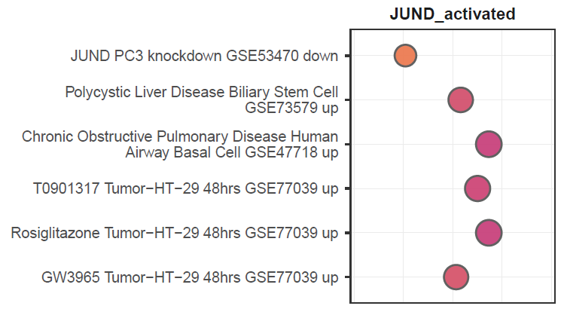
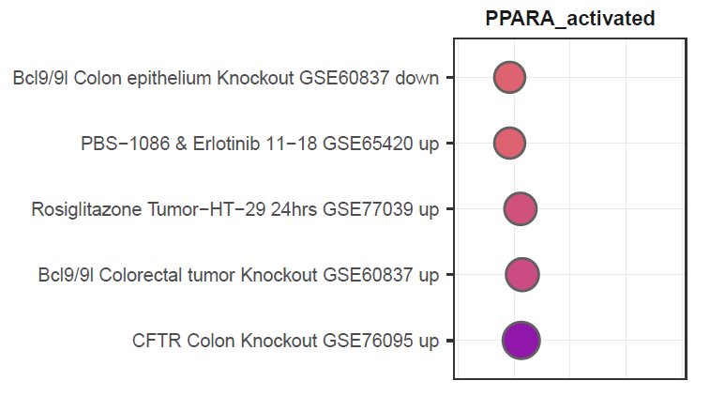
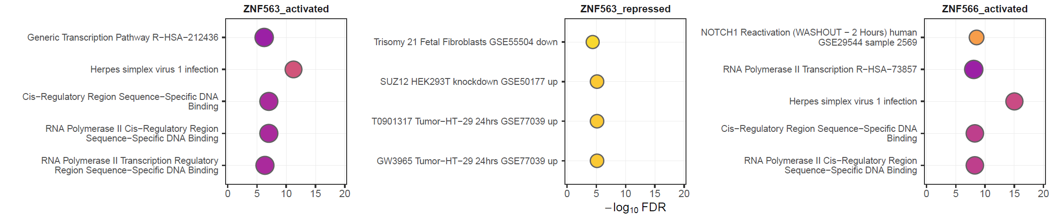
Predited TF-target genes pathway enrichments across nutrient stresses
Notes:
predicted TF–target pathway enrichments that are shared across multiple nutrient stresses. We see consistent activation of stress-responsive regulators like JUN and PPARA, both linked to metabolic and inflammatory signaling. ZNF563 and ZNF566 show broad involvement in transcriptional and chromatin regulation — suggesting general stress-induced remodeling of gene expression machinery. Together, these TFs represent conserved stress-response hubs across nutrient conditions.

Slide 37
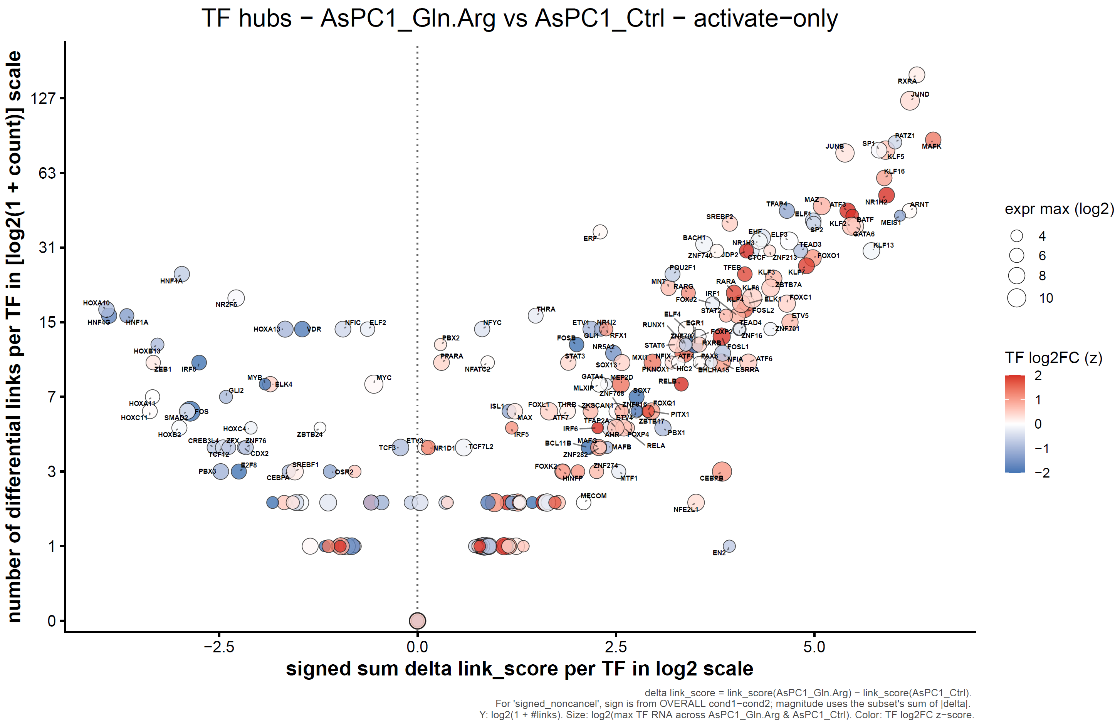
Consistency across regulatory priors and motif databases
30kb Jaspar2024

Slide 38

Consistency across regulatory priors and motif databases
Genehancer Jaspar2024

Slide 39

Consistency across regulatory priors and motif databases
Genehancer Hocomoco v13

Slide 40
Conclusions
Developed episcope, a modular framework for condition-specific GRN analysis using ATAC + RNA integration.
Applied to nutrient-stress PDAC data and produced clearer, more accurate GRNs than traditional methods.
Validated predictions with multiple KO/KD datasets and our HPAFII HNF4A KO, correctly predicting HNF1A / LGALS4 down.
Revealed shared mesenchymal-like programs across cell lines and stress types.
Identified key TF hubs and regulatory topics driving adaptive states.
Delivered rich interactive visualizations — lighting networks, differential and Δ-TF subnetworks.
Demonstrated episcope’s reproducibility and biological precision across diverse regulatory priors as well as motif databases.

Slide 41
Future Directions
Integrate 3D chromatin (Hi-C) data to refine enhancer–gene regulatory links.
Apply episcope to additional PDAC and external datasets for broader validation.
Expand validation using more KO/KD and perturbation studies.
Extend episcope to single-cell ATAC + RNA for cell-state–resolved GRN inference.
Enhance automation and visualization for scalable multi-condition GRN discovery.

Slide 42
Acknowledgment
Yi Lab members
Benjamin A. Colon-Emeric
Raghav Karthikeyan
Johnny Velasquez
Zihao Sui
Ting Wang
Mia N.Y. Shujath
Shigekazu Murakami
Committee members
Dr. Chunling Yi
Dr. Hakima Amri
Dr. Nathan Edwards
Dr. Sreejith Nair
Dr. Robert Suter
Notes:
I’d like to first thank Professor Yi, my mentor, for her guidance, patience, and continuous support throughout this project. I also want to sincerely thank all of my committee members — Dr. Amri, Dr. Edwards, Dr. Nair, and Dr. Suter — for their time, insights, and valuable feedback that helped shape this work. And finally, a big thank you to all the Yi Lab members for their help, discussions, and collaboration

Slide 43
Thank you!

Slide 44
Back Up Slides

Slide 45
Existing tools for inference of gene regulatory networks
Tool | Type of multimodal data | Type of modelling | Type of interactions | Statistical framework | Motif database | Default +/- distance cutoffs | ATAC-seq usage | Language
ARACNE | RNA-seq | Linear | Weighted | Frequentist | NA | NA | No ATAC (expression-only) | Java
GENIE3 | RNA-seq | Tree-based regression | Weighted | Frequentist | NA | NA | No ATAC | Python/R
GRNBoost2 | RNA-seq | Gradient boosting | Weighted | Frequentist | NA | NA | No ATAC | Python
PPCOR | RNA-seq | Correlation | Undirected (signed) | Frequentist | NA | NA | No ATAC | R
LEAP | RNA-seq (pseudotime) | Temporal correlation | Directed | Frequentist | NA | NA | No ATAC | R
SCODE | RNA-seq (time-series) | Linear ODE | Weighted | Frequentist | NA | NA | No ATAC | R
PIDC | RNA-seq | Information theory | Undirected | Frequentist | NA | NA | No ATAC | Python
SCRIBE | RNA-seq (time-series) | Directed information | Directed | Frequentist | NA | NA | No ATAC | Python
SINCERITIES | RNA-seq (time-stamped) | Granger causality | Directed / Signed | Frequentist | NA | NA | No ATAC | MATLAB / R
SCNS | RNA-seq (time-course) | Boolean logic | Directed / Discrete | Logical | NA | NA | No ATAC | MATLAB
GRNVBEM | RNA-seq (time-series) | Bayesian autoregressive | Directed / Signed | Bayesian | NA | NA | No ATAC | MATLAB / C++
GRISLI | RNA-seq (velocity / pseudotime) | Linear ODE | Weighted / Directed | Frequentist | NA | NA | No ATAC | R
SINGE | RNA-seq (pseudotime) | Kernel Granger causality | Directed / Weighted | Frequentist | NA | NA | No ATAC | Python
SCENIC | scRNA-seq | Linear | Signed, weighted | Frequentist | cisTarget/cisTarget | 150 kb / 150 kb | Indirect (TF motifs in promoter/enhancer peaks) | Python
SCENIC+ | scRNA-seq; scATAC-seq | Linear | Signed, weighted | Frequentist | cisTarget/cisTarget | 150 kb / 150 kb | ATAC peaks integrated with motif enrichment | Python
GRaNIE | ATAC-seq; RNA-seq | Linear | Weighted | Frequentist | JASPAR, HOCOMOCO/PWMscan | 250 kb / 250 kb | ATAC peaks correlated with expression | R
ANANSE | ATAC-seq; RNA-seq | Linear | Weighted | Frequentist | CIS-BP/GimmeMotifs | 100 kb / 100 kb | ATAC peaks + motif scores + differential accessibility | Python
CellOracle | scATAC-seq | Linear | Signed, weighted | Frequentist or Bayesian | CIS-BP/GimmeMotifs | 500 kb / 500 kb | ATAC peaks + motif activity | Python
DeepMAPS | scRNA-seq; scATAC-seq | Linear | Weighted | Frequentist | JASPAR/PWMScan | 150 kb / exon | ATAC peaks + co-embedding | Python
Dictys | scRNA-seq; scATAC-seq | Linear | Signed, weighted | Frequentist | HOCOMOCO/HOMER | 500 kb / 500 kb | ATAC peaks + motif scan | Python
FigR | scATAC-seq | Linear | Signed, weighted | Frequentist | CIS-BP/MOODs | 50 kb / 50 kb | ATAC peaks + motif regression | R
scGLUE | scRNA-seq; scATAC-seq | Non-linear | Weighted | Frequentist | JASPAR/cisTarget | 150 kb / 150 kb | Peak–gene graph embeddings (correlation-based) | Python
MAGICAL | scRNA-seq; scATAC-seq | Non-linear | Weighted | Bayesian | CIS-BP, ENCODE/MOODs | Based on Hi-C | ATAC peaks integrated with chromatin contacts | R / MATLAB
MICA | scRNA-seq; scATAC-seq | Non-linear | Signed, weighted | Frequentist | HOCOMOCO, JASPAR/motifanalysis | Nearest TSS | ATAC peaks + motif activity | R
scAI | scRNA-seq; scATAC-seq | Linear | Weighted | Frequentist | CIS-BP/MOODs | 250 kb / 250 kb | Peak–gene co-variation | R
sc-compReg | scRNA-seq; scATAC-seq | Linear | Binary | Frequentist | Undefined | Undefined | Binary integration of accessible vs. closed peaks | R
Symphony | scRNA-seq; ATAC-seq | Linear | Signed, weighted | Bayesian | FIMO | Nearest TSS | ATAC footprints and promoter peaks | Python
TimeReg | ATAC-seq; RNA-seq | Linear | Binary | Frequentist | HOMER | Undefined | Time-resolved peak–gene dynamics | MATLAB
TRIPOD | scRNA-seq; ATAC-seq | Non-linear | Signed, weighted | Frequentist or Bayesian | HOCOMOCO, JASPAR/MOODs | 100 kb / 100 kb | ATAC peaks + footprint motifs + dynamics | R
TOBIAS | ATAC-seq | Linear / motif regression | Signed, weighted | Frequentist | JASPAR, HOCOMOCO | Motif window ±50 bp | ATAC footprint scores at motif sites | Python
episcope | ATAC-seq; RNA-seq | Linear + correlation network | Signed, weighted | Frequentist or Bayesian | GeneHancer, JASPAR, HOCOMOCO | 30 kb upstream/downstream | ATAC footprint scores & peaks linked to genes | Python/R
Unpublished data, Yi Lab, 2025

Slide 46
Quick summary of how ATAC data are used
ATAC usage type | Description | Tools
Peaks as accessibility features | Uses binary or quantitative peak accessibility to link enhancers to genes. | GRaNIE, ANANSE, FigR, DeepMAPS, scAI
Footprint scores*/ motif occupancy | Uses per-base footprinting to infer TF binding activity changes. | TOBIAS, episcope
Chromatin graph embeddings | Integrates peak–gene correlations or co-embeddings in latent space. | scGLUE, MICA
Hi-C or proximity-based linking | Uses 3D chromatin contact maps to weight peak–gene edges. | MAGICAL
Binary accessible integration | Combines open/closed chromatin with single-cell expression states. | sc-compReg, TimeReg
Motif enrichment-based scoring** | Scans accessible peaks for motifs and computes motif–gene edge confidence. | SCENIC+, Dictys, Symphony
*Footprint scoring: detects where a TF actually binds by identifying local Tn5 cut depletion patterns (protected footprints) within those motifs.
**Motif enrichment–based scoring: identifies potential TF binding sites by scanning accessible chromatin peaks for known motifs and measuring how strongly those motifs are overrepresented compared to background regions, reflecting binding opportunity rather than actual occupancy.
Unpublished data, Yi Lab, 2025

Slide 47

GRN using GRaNIE

Slide 48
Introduction and Motivation
Recent studies show that PDAC cells, under nutrient stress, employ bulk fluid‐phase endocytosis to internalize extracellular proteins for amino acid supply (Commisso et al., 2013), degrade collagen-derived proline to fuel the TCA cycle under low-glucose/glutamine conditions (Olivares et al., 2017), and upregulate arginine biosynthesis in response to arginine depletion in the tumor microenvironment (Apiz Saab et al., 2023).
Citations:
Commisso C, et al. (2013). Nature. 497(7451):633–7.
Olivares O, et al. (2017). Nat Commun. 8:16031.
Apiz Saab E, et al. (2023). eLife. 12:e81289.
Objective: Integrate transcriptomic, epigenomic, and chromatin accessibility data to identify lineage-associated programs and determine how nutrient stresses affect them.

Slide 49
Overview of Study Design
Multi-modal analysis using:
CCLE RNA-seq (Lineage Discovery): PDAC cell lines (n = 41)
Nutrient Stress RNA-seq: HPAFII, AsPC1, Panc1 cell lines
In-house CUT&Tag: 5 cell lines × 5 histone marks (H3K27ac, H3K27me3, H3K4me3, H3K9me3, pPolII-S2/5) = 25 libraries (n = 25)
In house Nutrient stress RNA-seq (dynamic response): Nutrient conditions (n = 10)
0% FBS; 10% FBS (control); 10% FBS + TGFβ;
10% FBS with glucose deprivation;
10% FBS with 25% BCAA;
10% FBS with 25% glutamine/arginine;
10% FBS with lysine deprivation;
10% FBS with tryptophan deprivation;
10% FBS with low Met/Cys at 12.5 µM;
10% FBS with very lowMet/Cys at 3.125 µM.
In house & public ATAC-seq (TOBIAS TF footprinting)
ATAC-seq (PDAC, n = 17): across five cell lines—HPAFII (n = 3), AsPC1 (n = 5), Panc1 (n = 4), MiaPaca2 (n = 3), CaPan1 (n = 2)
ATAC-seq (Nutrient Stress, HPAFII, AsPC1, Panc1): under the same nutrient conditions as above (n = 30)

Slide 50
Overview of Study Design
Nutrient-controlled lineage-associated genes
Integrated Data Flow and Cross-Modal Connections
CCLE RNA‐seq and HPAFII nutrient RNA‐seq jointly define the “nutrient‐controlled lineage‐associated gene” set.
CUT&Tag + ChromHMM annotations at those genes’ regulatory loci reveal baseline chromatin states that distinguish Epi vs. Mes.
PDAC ATAC + TOBIAS validate which TFs bind each gene’s cis-elements, confirming lineage‐specific regulatory circuits.
Nutrient ATAC + TOBIAS demonstrate dynamic remodeling of the same cis-elements and TF–gene edges under nutrient stress, linking chromatin, TF occupancy, and transcription.
CCLE RNA-seq
(41 PDAC lines)
Identify Lineage
Markers
Nutrient RNA-seq
(HPAFII; 10 cond.)
Identify Nutrient-
Controlled Genes
CUT&Tag +
ChromHMM
Annotate
Regulatory Regions
Lineage-associated genes
PDAC ATAC-seq + TOBIAS
Footprinting
Validate TF Binding
Nutrient ATAC-seq
(HPAFII; 10 cond.)
Accessibility &
Footprint Dynamics

Slide 51


Establishing Lineage-Associated Gene Signatures
Elastic Net Model: Train EN regression using DE genes to learn EMT scores (0 = Epi, 1 = Mes).
DESeq2: Perform differential expression analysis between MiaPaCa2 & Panc1 (Mes) vs. HPAFII & Capan1 (Epi).
Epi
Int
Mes
CCLE RNA-seq (PDAC cell lines)
Define Lineages and Model EMT Axis
Differentially Expressed Genes
Correlation with EMT Score
Intersect DE Genes and EMT-Correlated Genes
Epi
Score Cell Lines: Calculate EMT scores for all PDAC cell lines based on trained EN model.
Mes
Unpublished data, Yi Lab, 2025

Slide 52

Lineage-Associated TF Footprints
Heatmap of differential footprints across lineages
Mes
Epi
Int
Unpublished data, Yi Lab, 2025

Slide 53

Lineage-Associated TF Footprints
Heatmap of differential footprints across lineages
Mes
Epi
Int
Unpublished data, Yi Lab, 2025

Slide 54

Modified TOBIAS Footprinting to Identify Lineage TFs
Compute TOBIAS footprints
Compared 3 MiaPaCa2 (Mes) + 4 Panc1 (Mes) vs. 2 HPAFII (Epi) + 3 Capan1 (Epi) using our customized TOBIAS BINdetect algorithm
Unpublished data, Yi Lab, 2025

Slide 55

Nutrient × TGFB × Lineage Overlap
Weighted Venn Diagrams:
TGFB-induced vs Mes-lineage vs Nutrient-controlled Mes
TGFB-repressed vs Epi-lineage vs Nutrient-controlled Epi
While some overlap exists, nutrient stress may drive EMT through mechanistically distinct pathways compared to canonical TGFB-induced signaling.
Unpublished data, Yi Lab, 2025

Slide 56

Nutrient Stress Response of Lineage Programs
Nutrient−controlled lineage CCLE (Mes vs. Epi down) genes heatmap (ward.D2, Euclidean)
RNA-seq Response Under Nutrient Stress
Intersected nutrient stress DE genes with lineage genes
Clustered response patterns
Heatmap of nutrient-controlled lineage genes
FBS
Trp
Lys
BCAA
Glc
Met.Cys
Gln.Arg
Unpublished data, Yi Lab, 2025

Slide 57

Nutrient Stress Response of Lineage Programs
Nutrient−controlled lineage CCLE (Mes vs. Epi up) genes heatmap (ward.D2, Euclidean)
RNA-seq Response Under Nutrient Stress
Intersected nutrient stress DE genes with lineage genes
Clustered response patterns
Heatmap of nutrient-controlled lineage genes
Gln.Arg
Met.Cys
Glc
BCAA
Lys
Trp
Unpublished data, Yi Lab, 2025

Slide 58

TOBIAS FP analysis of nutrient ATAC peaks
Unpublished data, Yi Lab, 2025

Slide 59





ATAC-seq (TFs’ FPs) + RNA-seq (Genes’) based GRN
Preprocessing
Epigenetics
Identify significant peak-to-gene links
GRN
Paired quantification
Transcriptomics
Gene regulatory network analysis
TSS
Matrix integration
Source: Unpublished data, Yi Lab, 2025

Slide 60
Transcription Factor Assignment using Footprint score to transcription factor expression
Individuals
ATAC
TF1 RNA
TF2 RNA
Individuals
TF1
Individuals
TF2
Peaks
Peaks
Peaks
TF1
TF2
TF1 Motifs
TF1 Motifs
TF1 Motifs
TF1 Footprints
+
TF1 Footprints
TF1 Footprints
+++
TF1
TF2
TF2 Motifs
TF2 Motifs
++
TF2 Motifs
TF2 Footprints
++
TF2 Footprints
++
TF2 Footprints
+++
R>>0; FDR <0.05
R~0
Unpublished data, Yi Lab, 2025

Slide 61
Correlation-Based Refinement - ATAC Peak to target genes expression
Targeted gene RNA
Targeted gene RNA
ATAC
Individuals
GeneA
Individuals
GeneB
GeneA
GeneB
GeneA
GeneB
R~0
R>>0|R<<0; FDR <0.05
Unpublished data, Yi Lab, 2025

Slide 62
Correlation-Based Refinement - Footprint score to targeted gene expression
ATAC
Peaks
Motifs
Footprints
+++
+++
+++
Targeted gene RNA
Targeted gene RNA
Individuals
GeneA
Individuals
GeneB
Individuals
Peaks
GeneA
GeneB
Motifs
Footprints
++
++
++
GeneA
GeneB
R>>0|R<<0; FDR <0.05
Peaks
R~0
Motifs
Footprints
+
+
+
Unpublished data, Yi Lab, 2025

Slide 63

Predict essential TF via Hyperlink-Induced Topic Search (HITS)
Use the directed graph where nodes = TFs, enhancers, genes; edges = regulatory links (TF→enhancer, enhancer→gene) we have for each delta condition
Assign each node a hub score ℎ𝑝​ and an authority score 𝑎𝑝​, initialized to 1 (or uniform). Iterative update rules:
​where 𝑞→𝑝 denotes edges pointing into 𝑝, and 𝑝→𝑟 edges going out from 𝑝.
After convergence (with normalization each iteration), TFs with highest hub scores are those that regulate many strong target nodes (authorities) → implying potential essential regulators.
Unpublished data, Yi Lab, 2025
Notes:
In the same way search engines find pages that are good directories (hubs) and good content sources (authorities), we use the HITS logic on our regulatory network to find TFs that act as broad regulators (hubs) feeding into many well-regulated target modules (authorities). Those TFs with high hub scores are our top candidates for essential regulators in PDAC under nutrient stress.

Slide 64


Secreted
Unpublished data, Yi Lab, 2025

Slide 65

Transcription factors RNA-seq
Unpublished data, Yi Lab, 2025

Slide 66

Nutrient stress on spatial data (Pei, et.al)

